Slide 1
CASE STUDY-6
ADITYA KALRA
ARKA SAHA
ARSH RAJ
CHAITANYA THAPLIYAL
HIMANSHU JAKHMOLA

Slide 2
AGENDA
Introduction​
Primary goals
​Areas of growth
Timeline
​Summary​

Slide 3
Problem statement
This case study project focuses on the data engineering aspects of Geocart, an e-commerce ordering and delivery application. The objective is to enhance the shopping experience by utilizing transactional data and analyse it to get better insights. The project aims to design and implement a robust data pipeline that processes and analyzes a relational dataset of customer orders. This dataset, containing anonymized information from over a million orders, will be used to predict user behaviour such as repeat purchases, new product trials, and items added to the cart during a session. The primary goal is to create an efficient and scalable data engineering solution that supports accurate and real-time model predictions to optimize the user's shopping journey. The project will involve data ingestion, transformation, storage, and integration with machine learning models, ensuring a seamless and personalized shopping experience for Geocart users.

Slide 4
PRIMARY GOALS
The data pipeline will consist of the following key stages:
Data Ingestion.
Data Processing.
Data Storage.
Data Visualization and Reporting

Slide 5
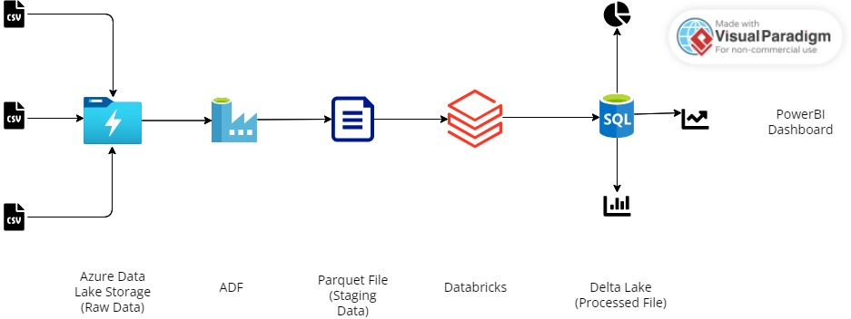
PIPELINE Architecture

Slide 6
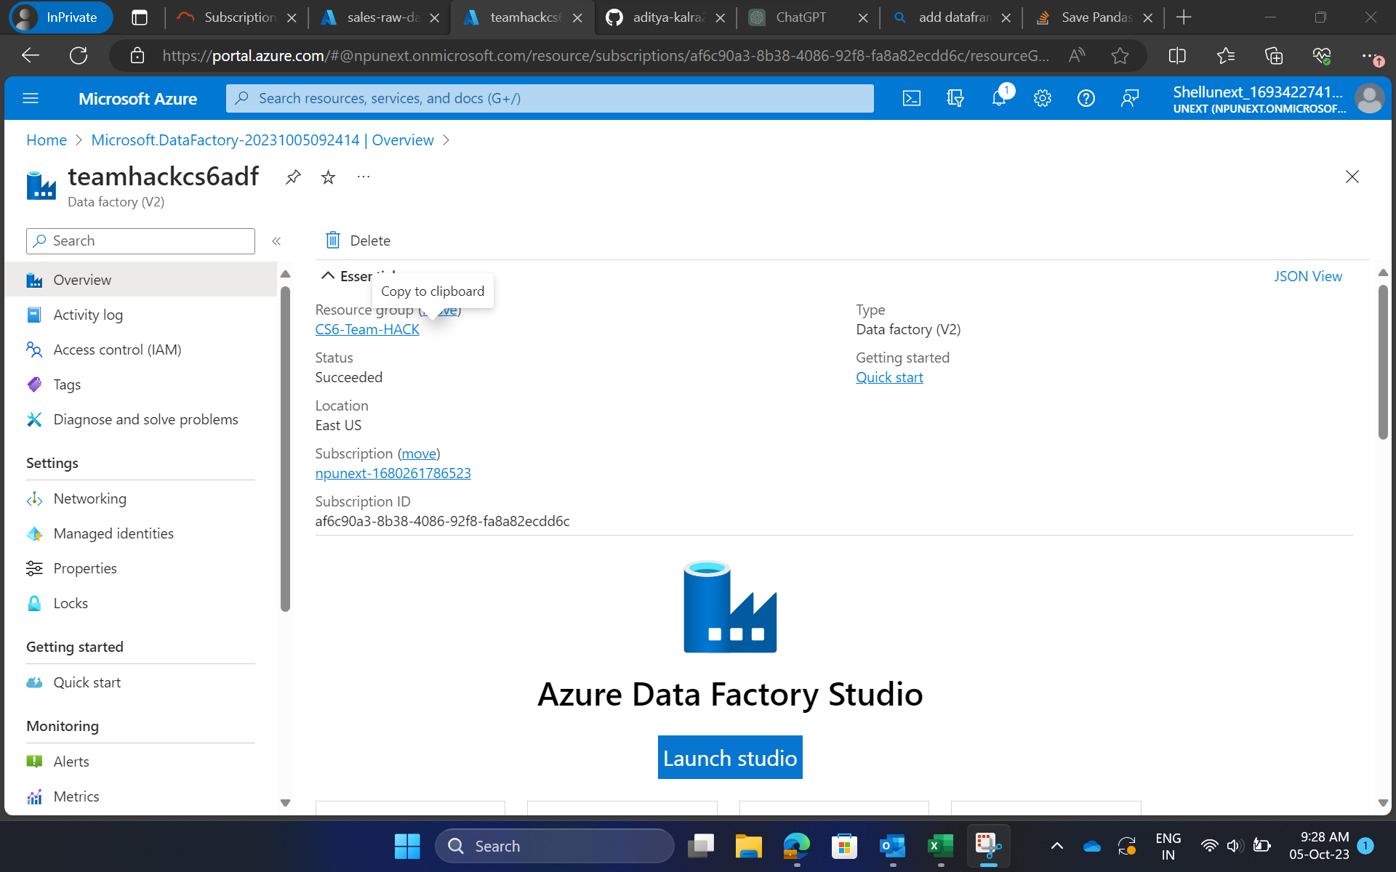
LAUNCHING Azure data factory

Slide 7
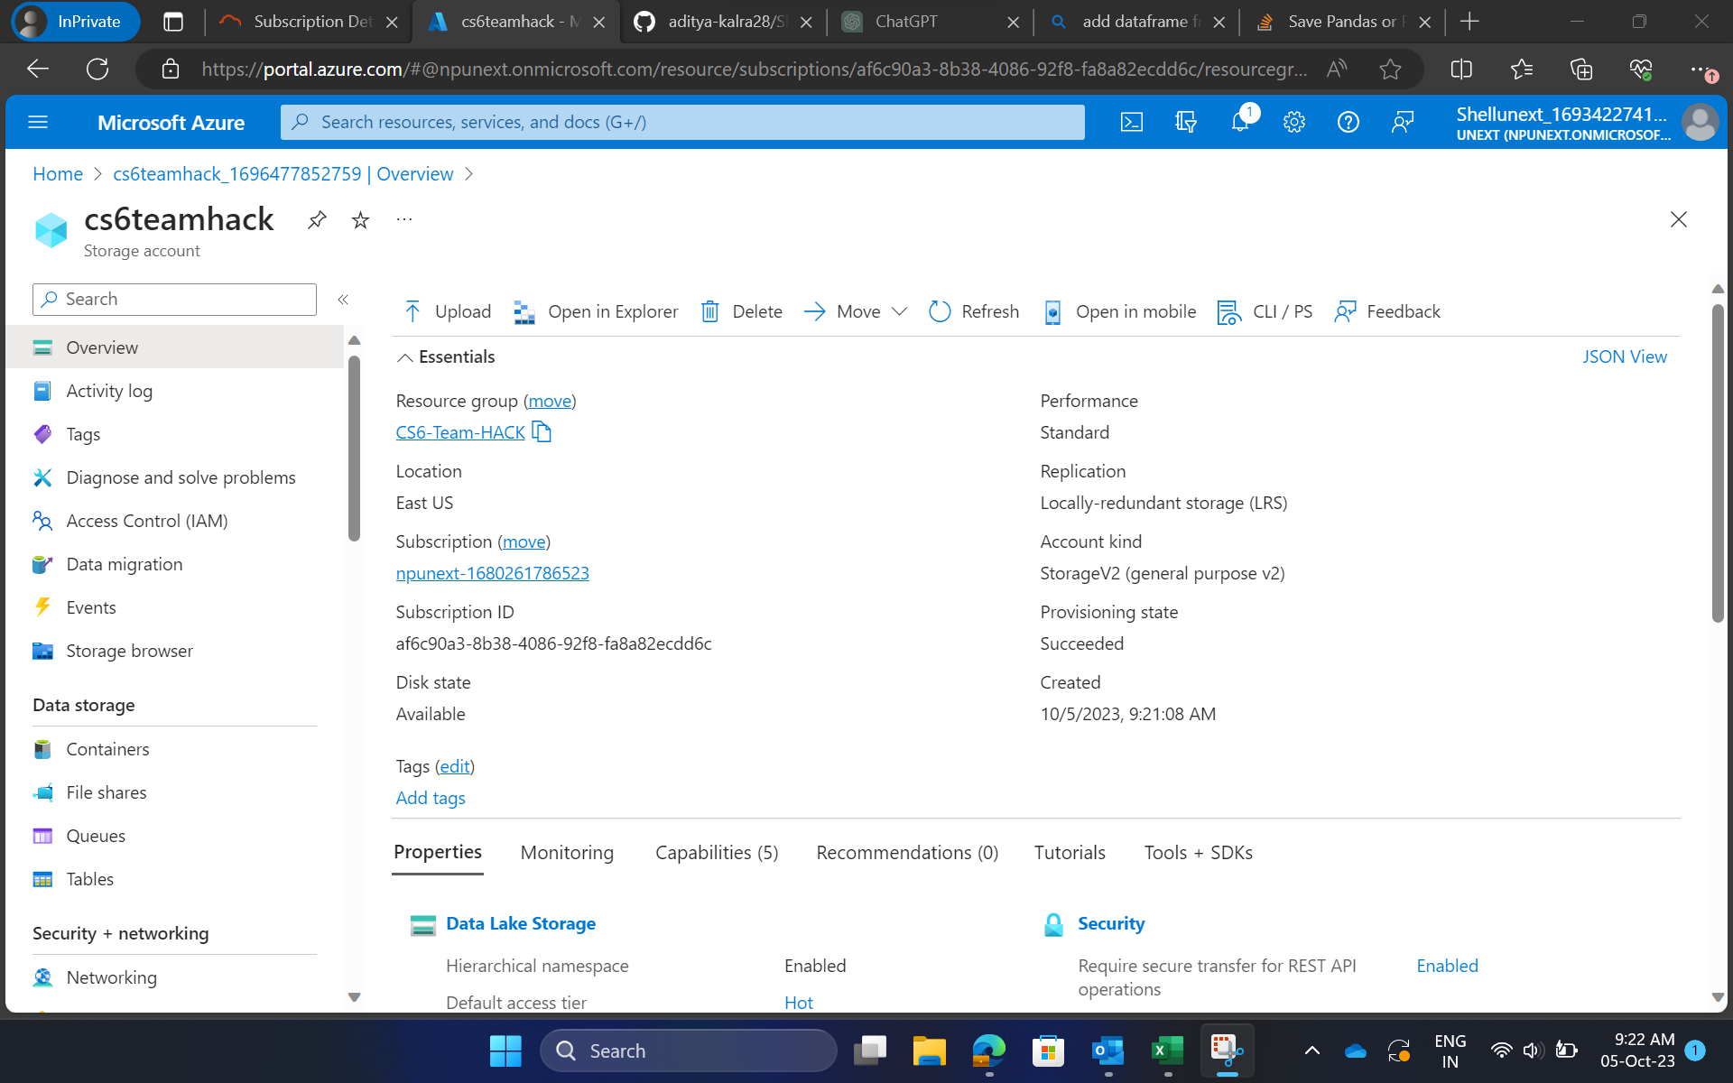
Creating Azure blob storage

Slide 8
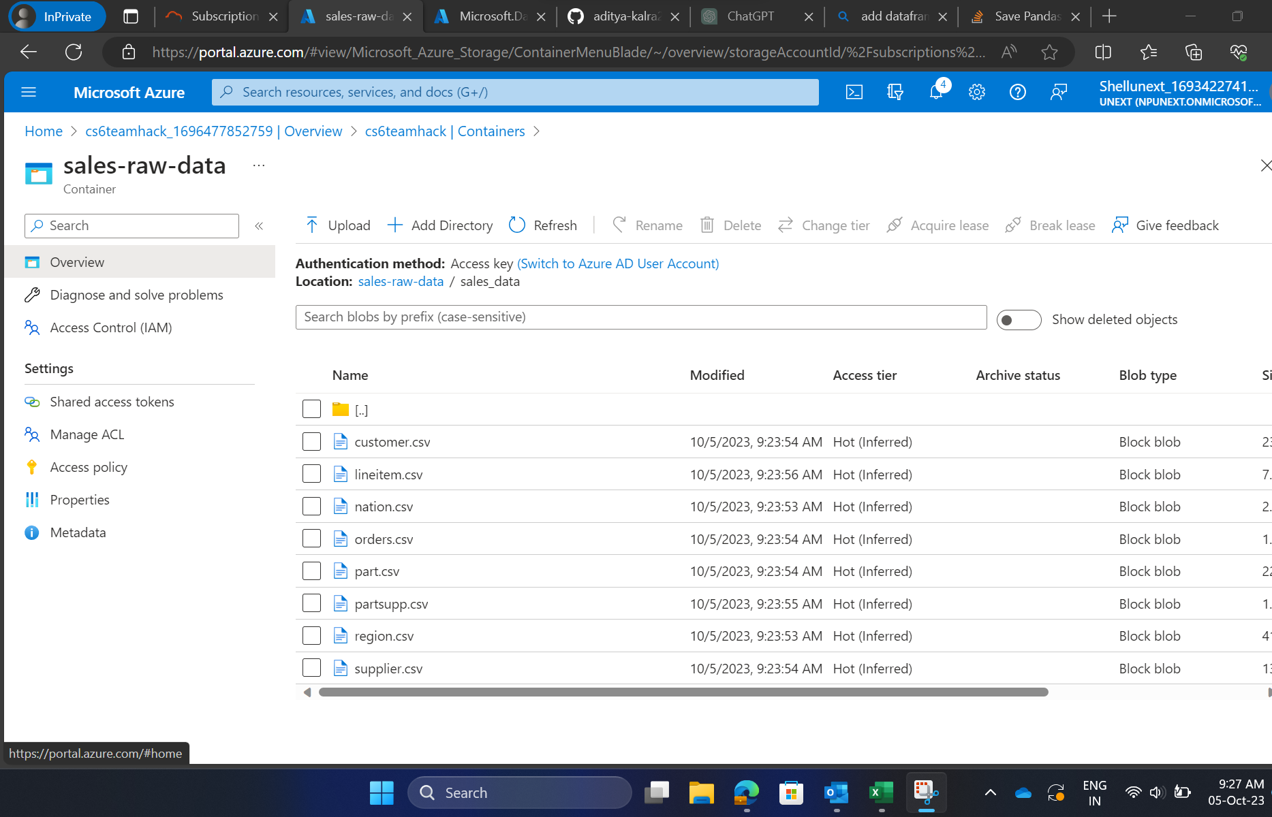
Uploading of data in blob

Slide 9
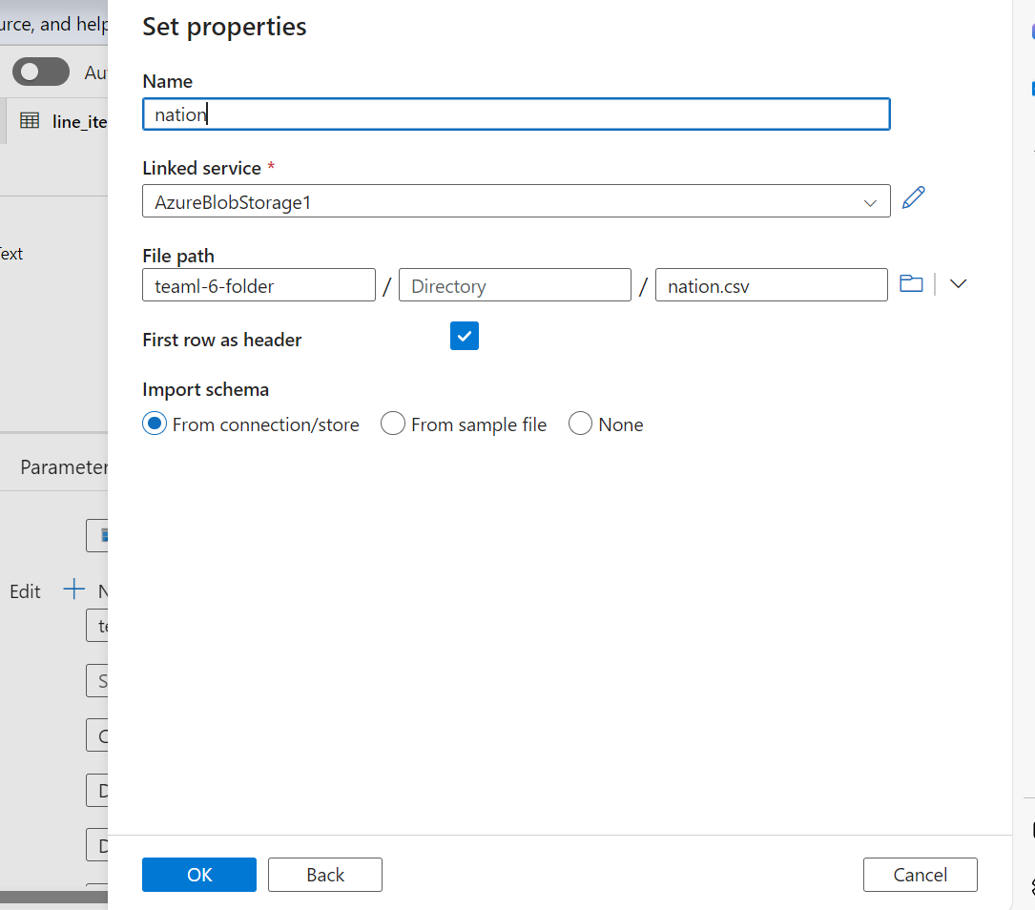
Creation of new Linked service

Slide 10
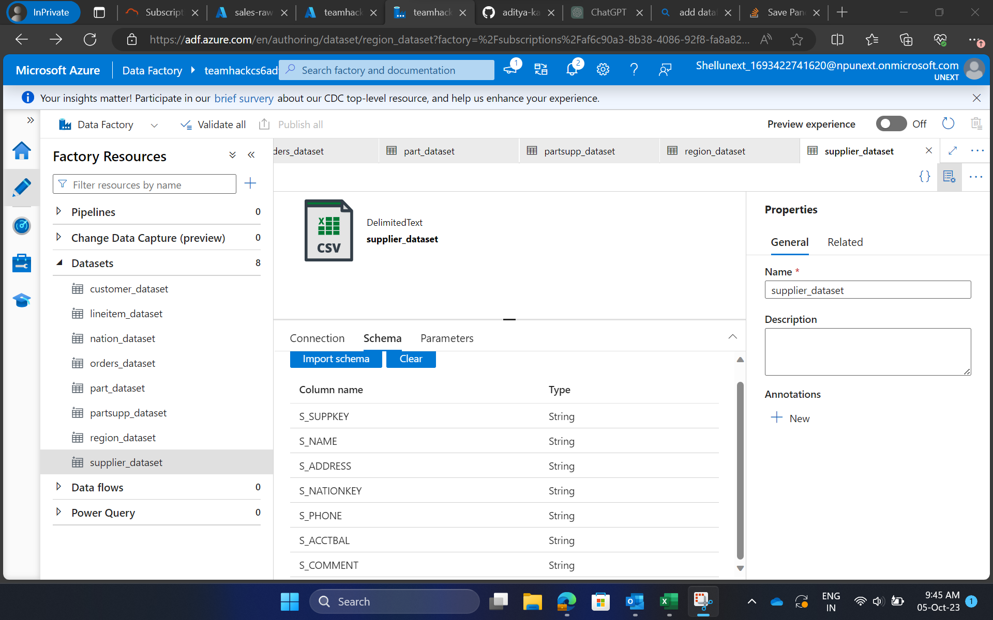
Importing of schema

Slide 11
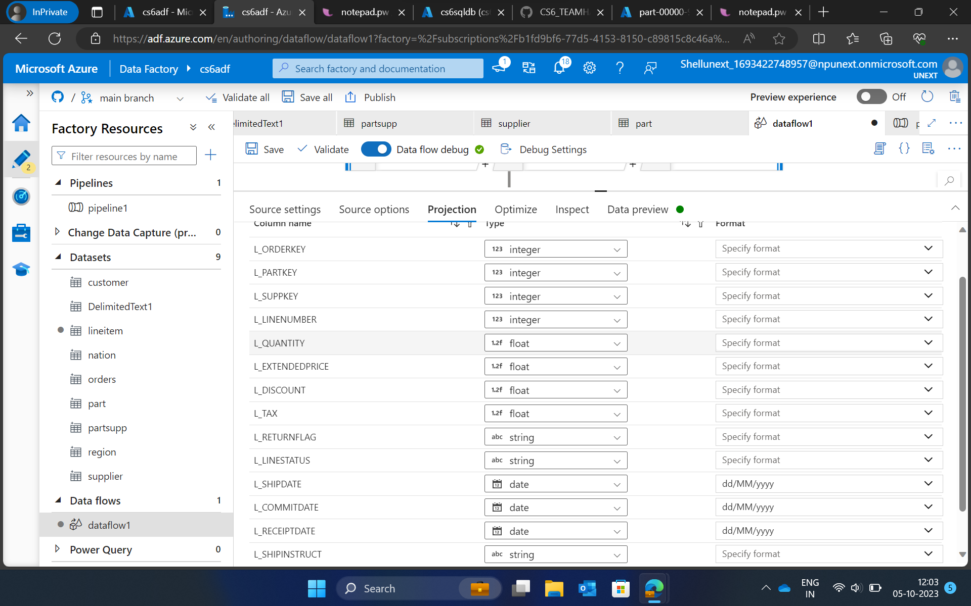
Changing the data type in projection

Slide 12
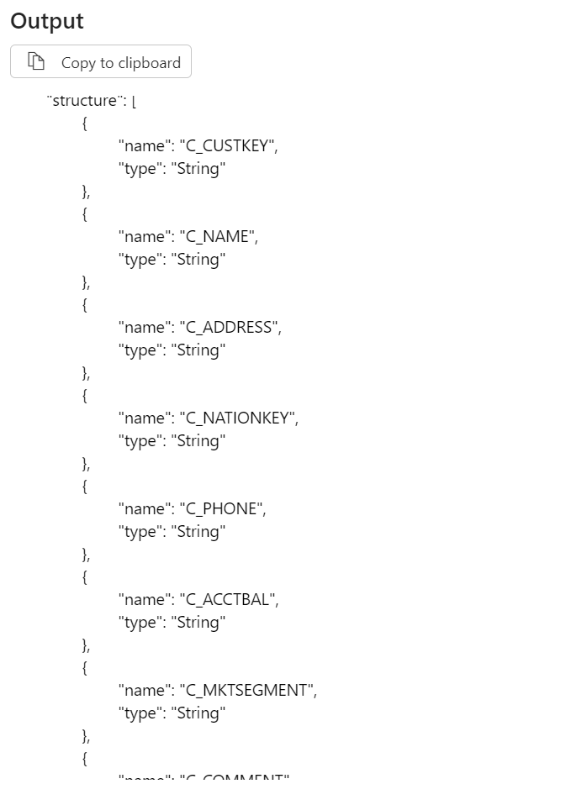
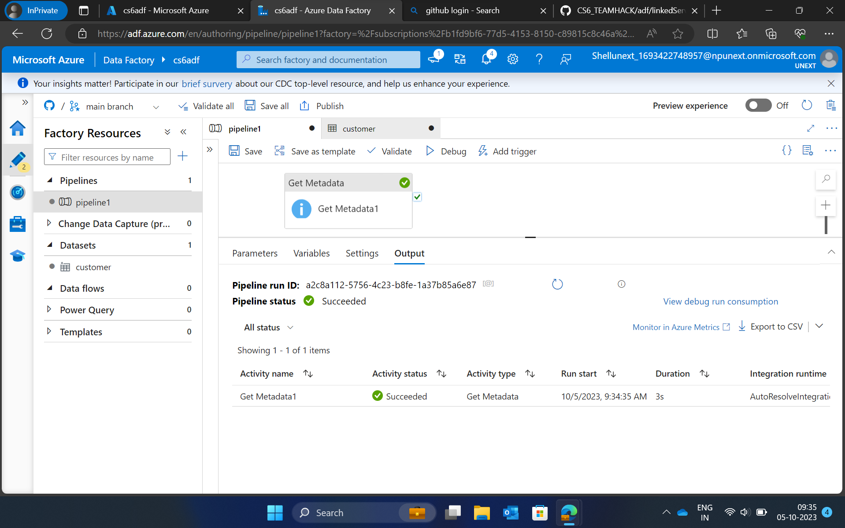
Creating meta data

Slide 13
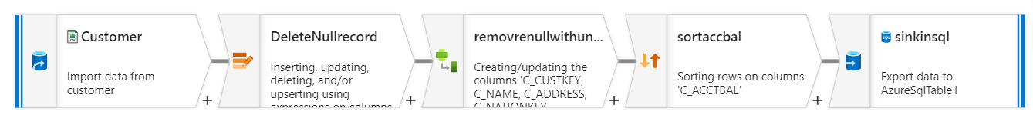
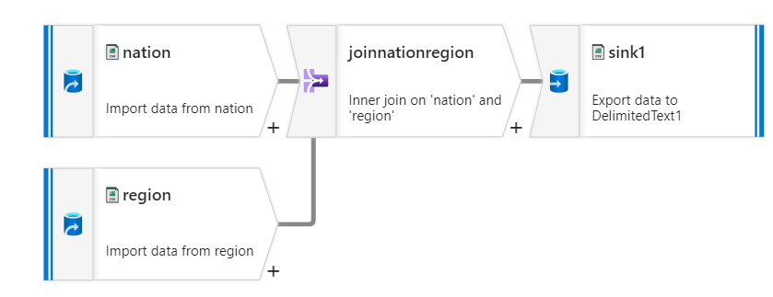
Different Transformations performed

Slide 14
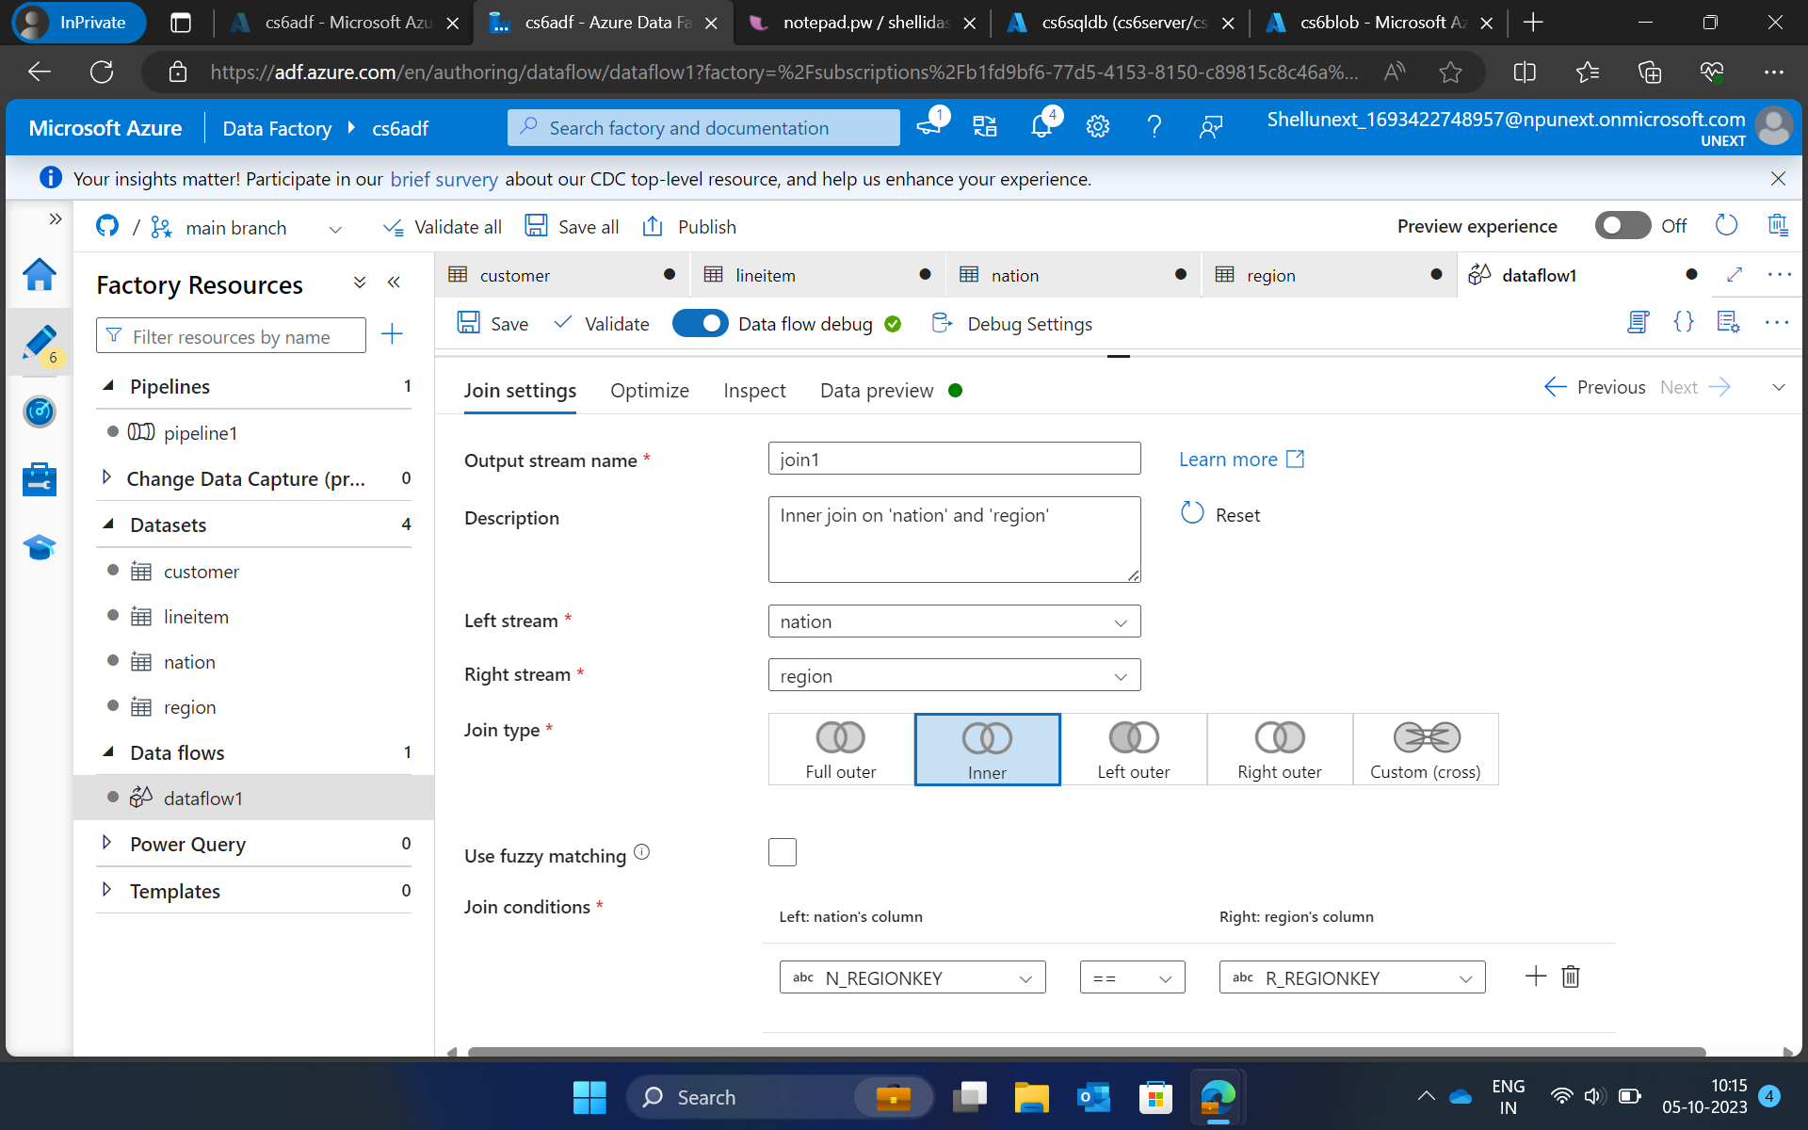
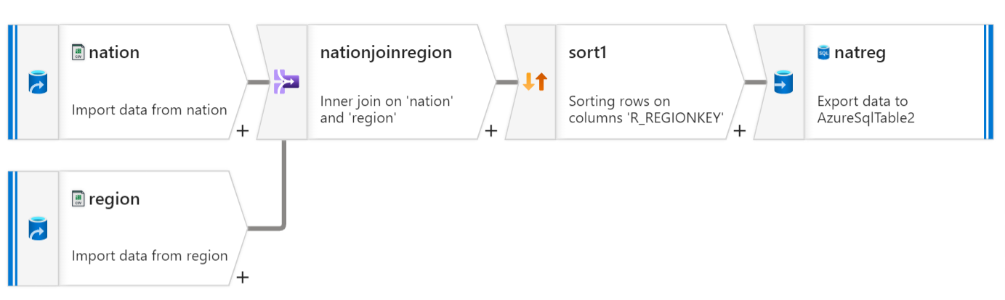
Joining of 2 tables

Slide 15
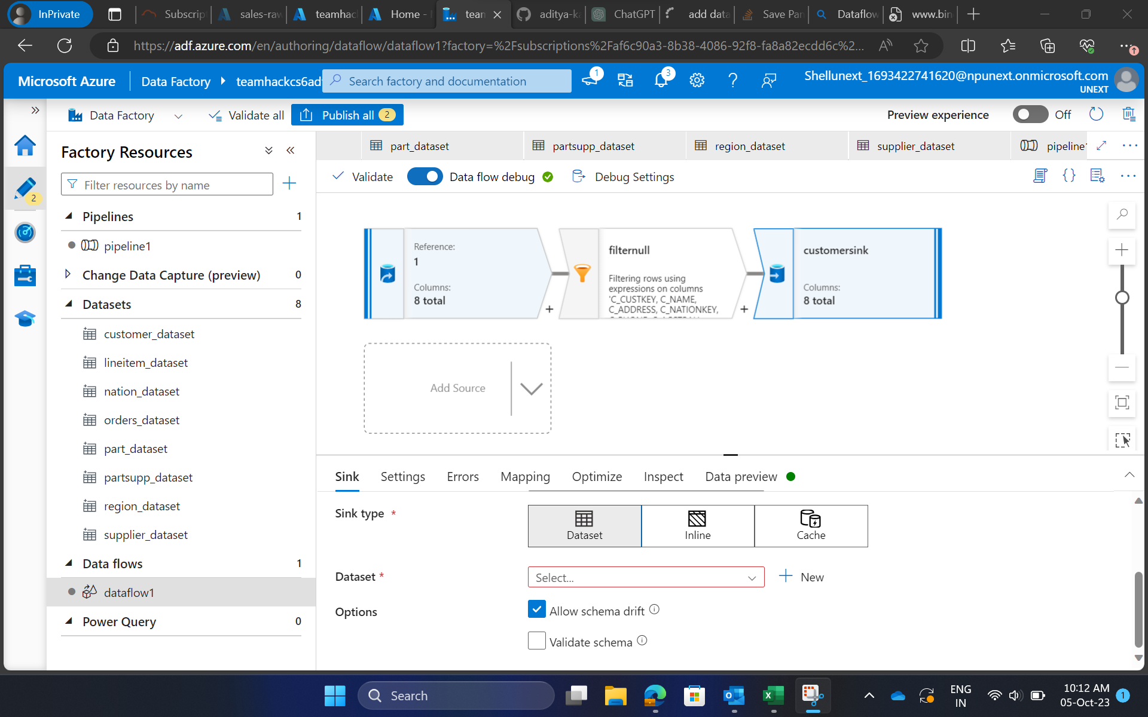
Dataflows

Slide 16
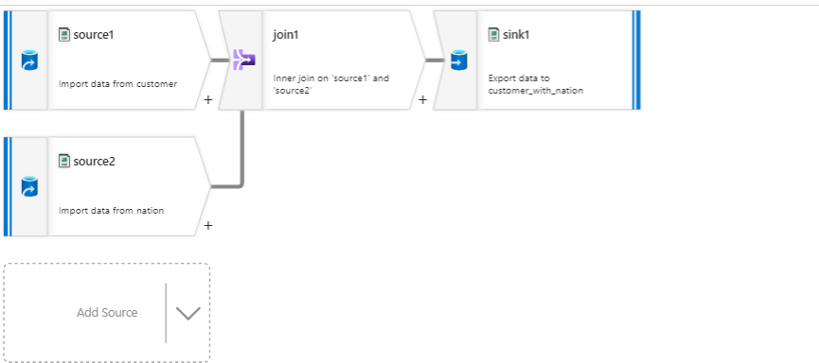
Joining of 2 tables

Slide 17
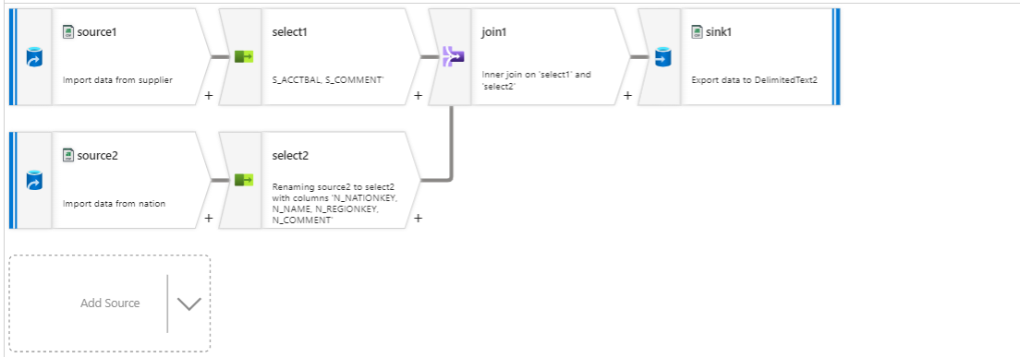

Slide 18
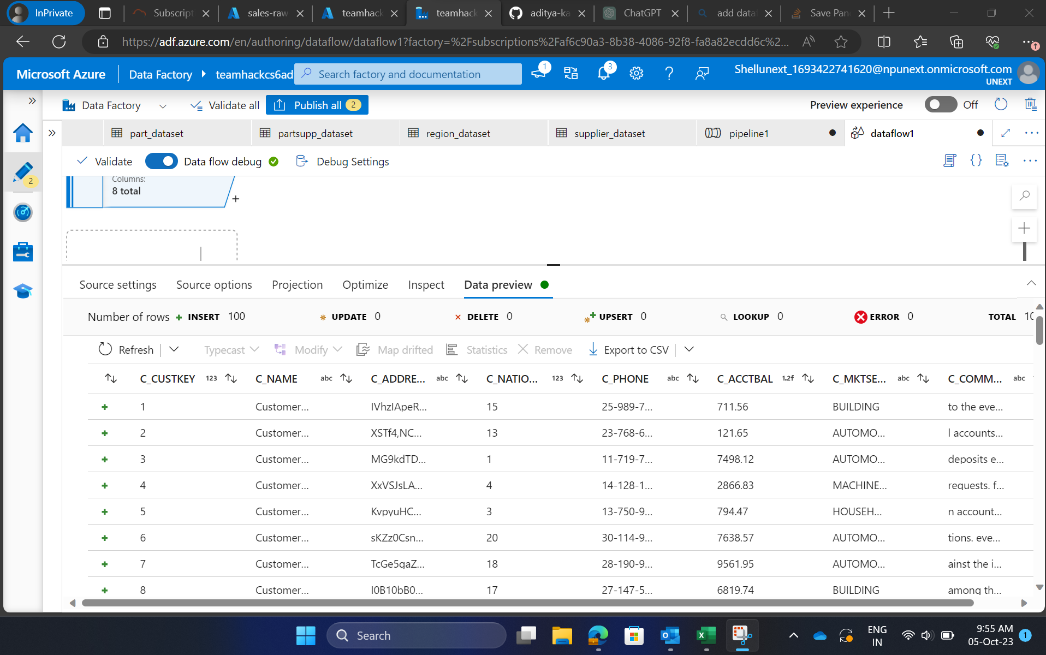

Slide 19
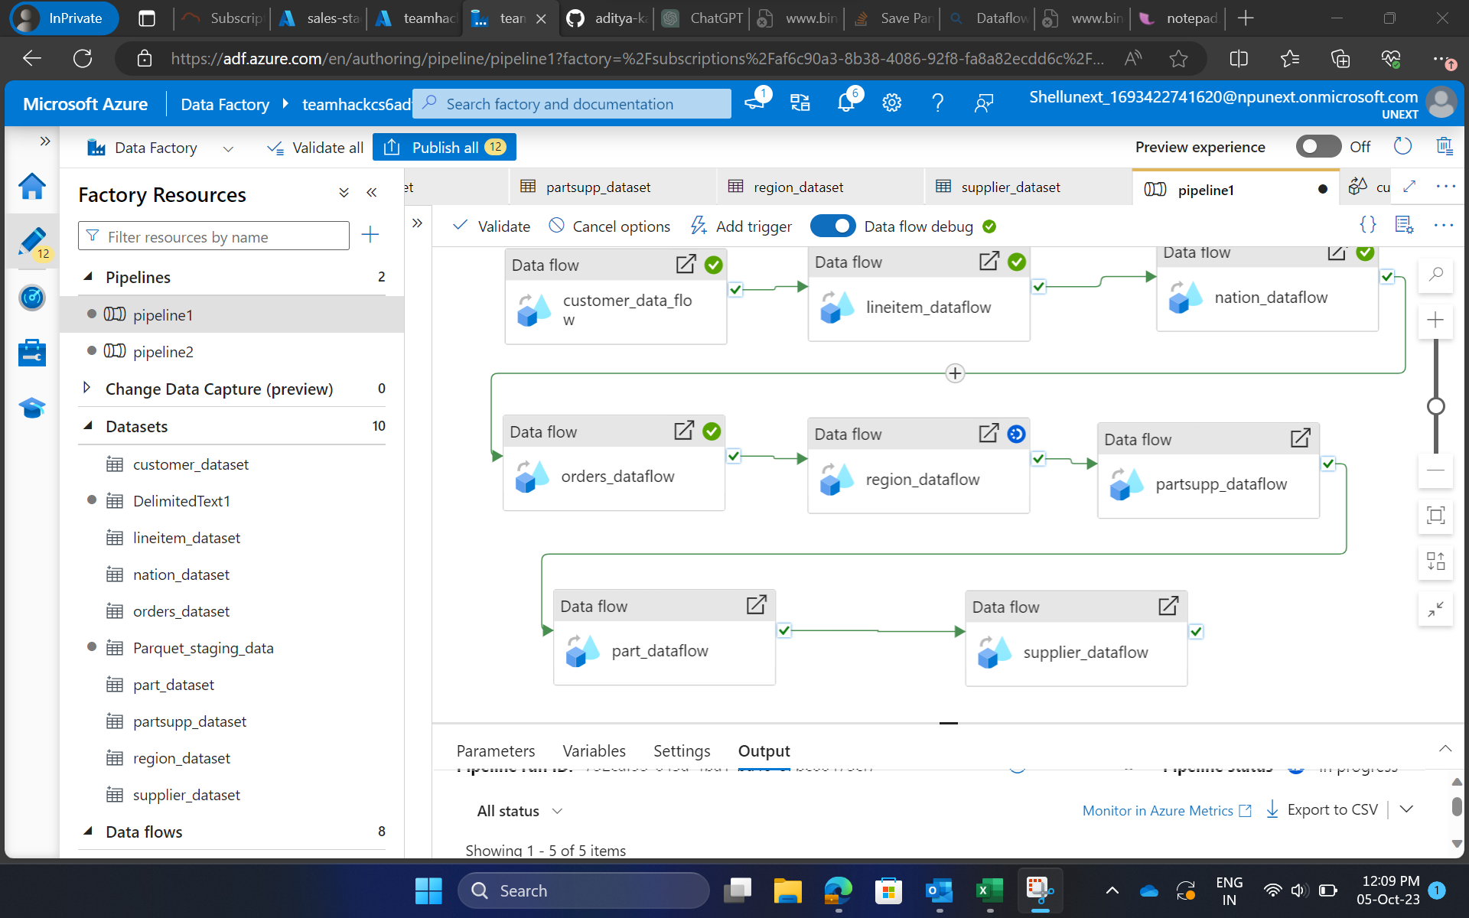
PIPELINE EXECUTION

Slide 20
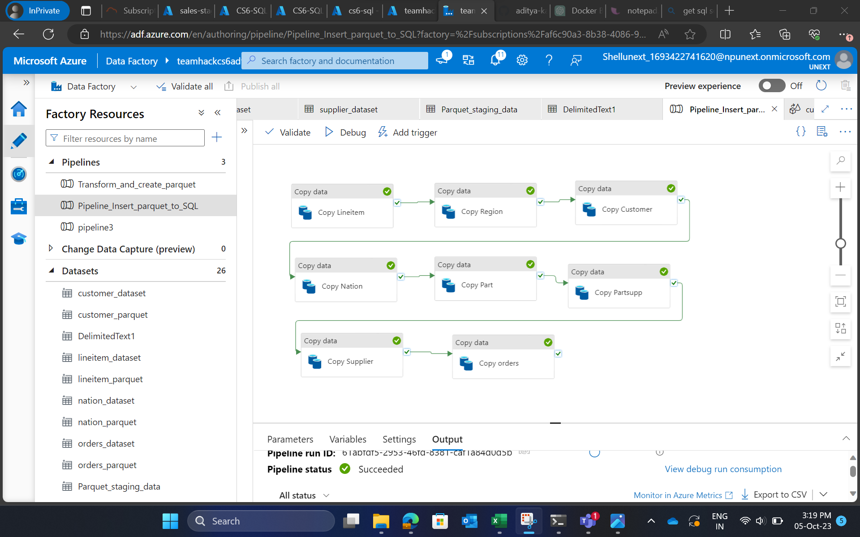
Pipeline for parquet file

Slide 21
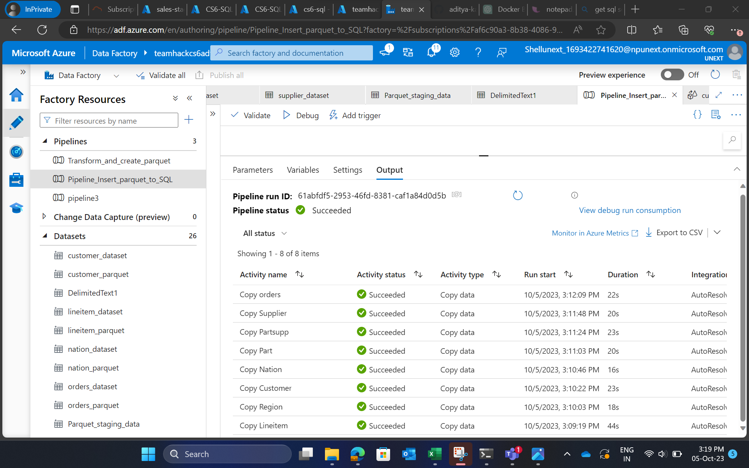
Successful run

Slide 22
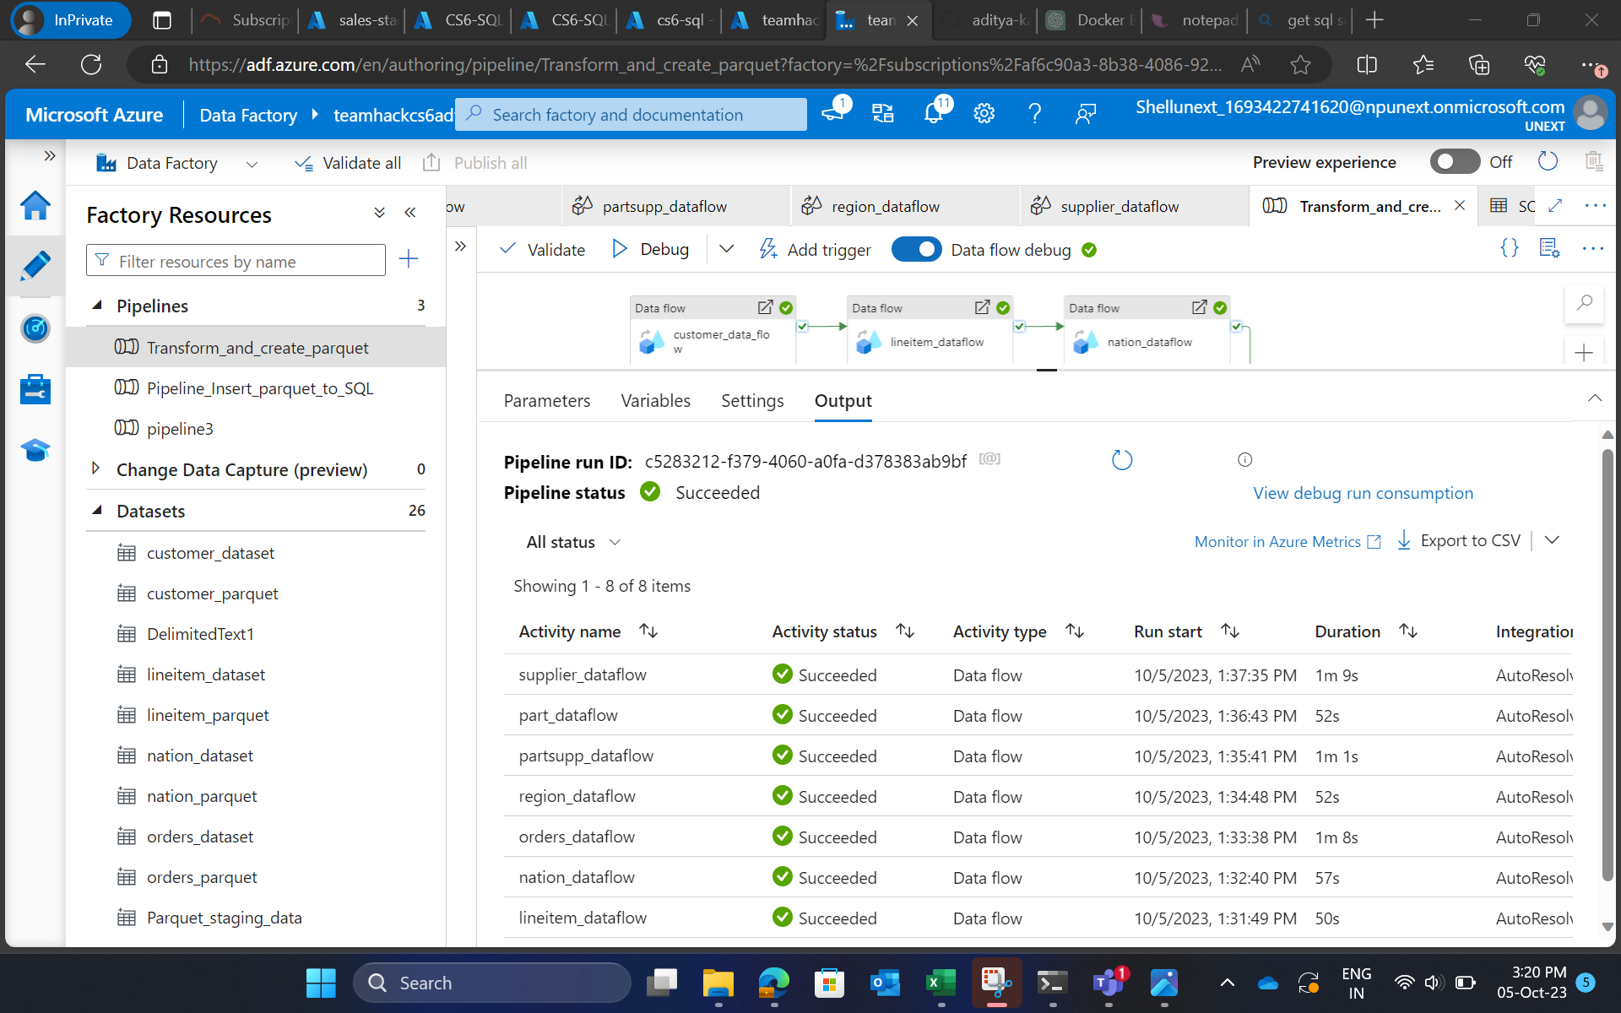

Slide 23
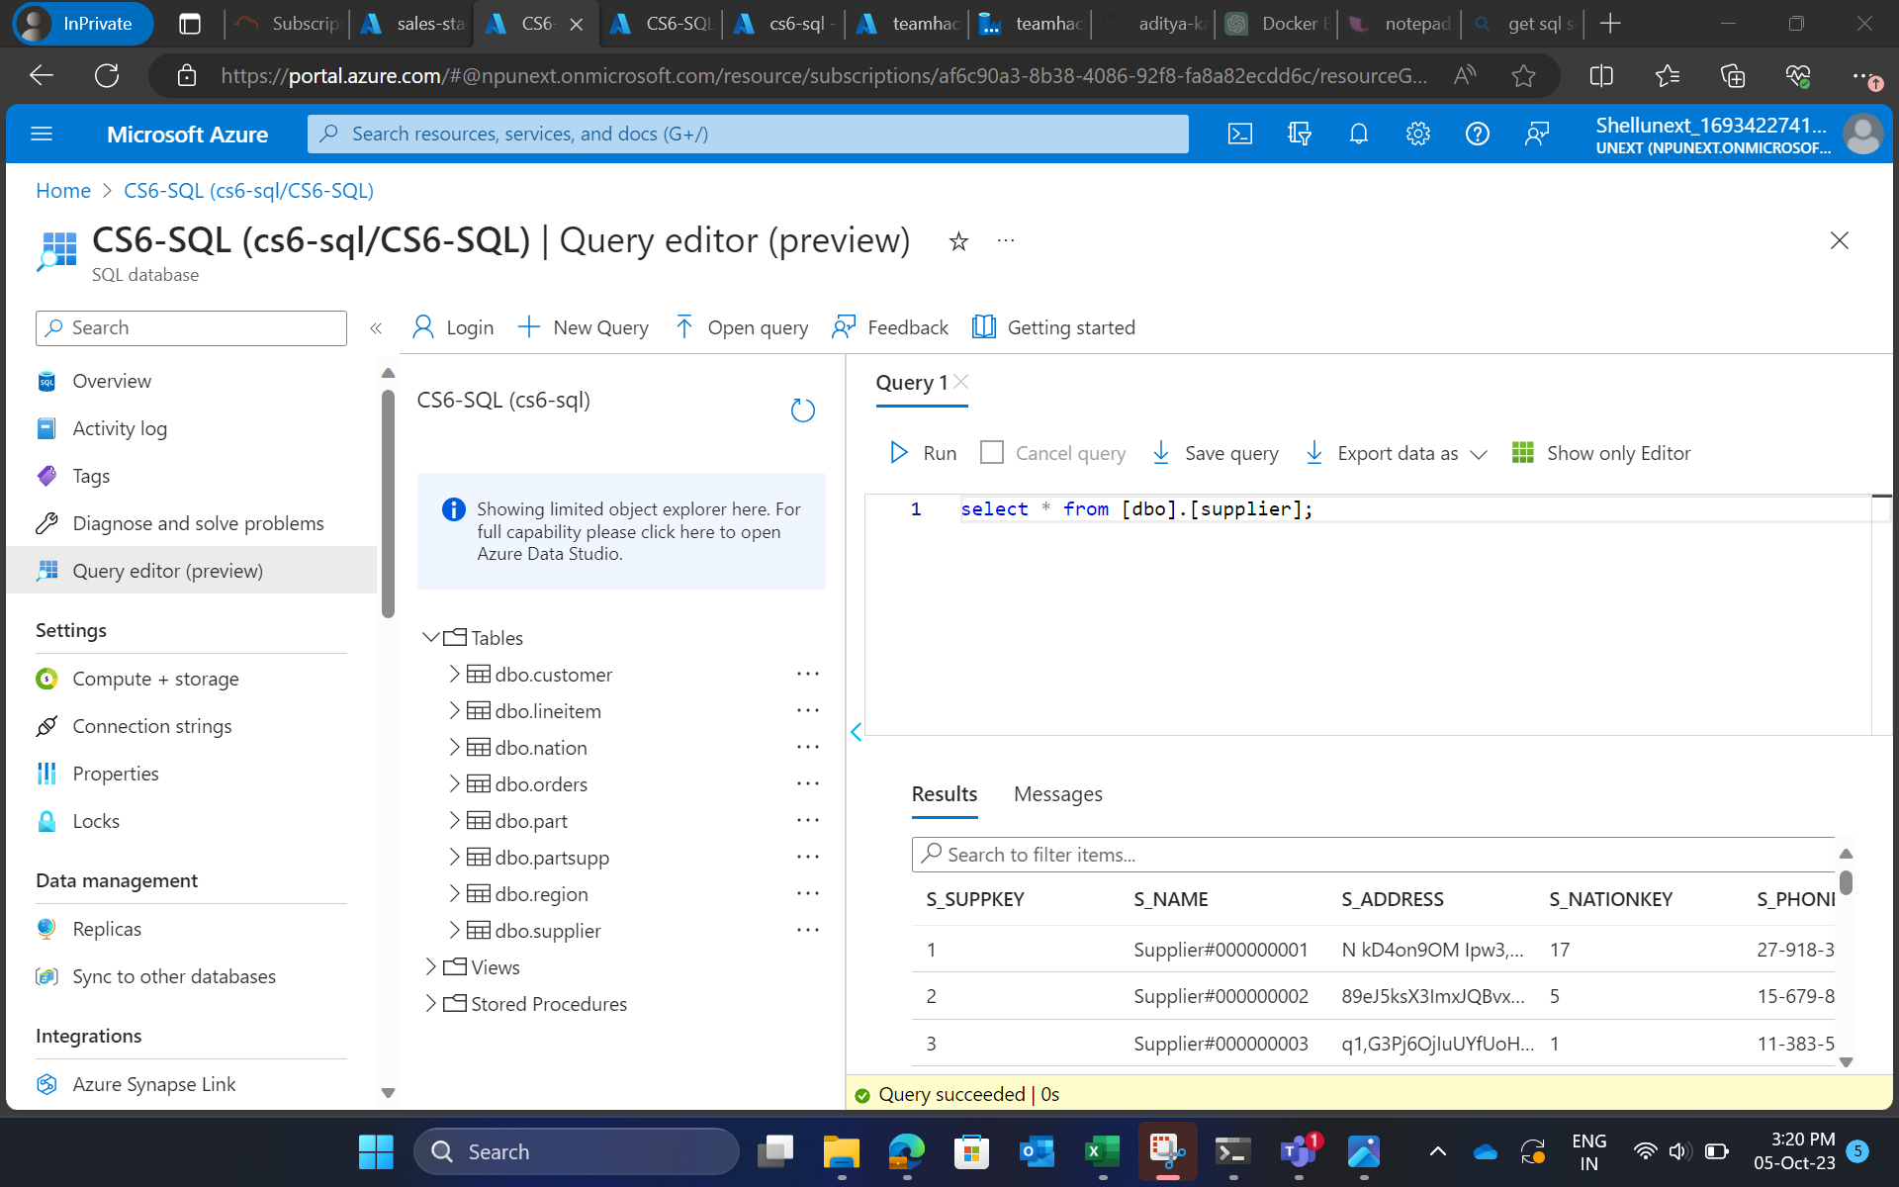
Files added to SQL DB

Slide 24
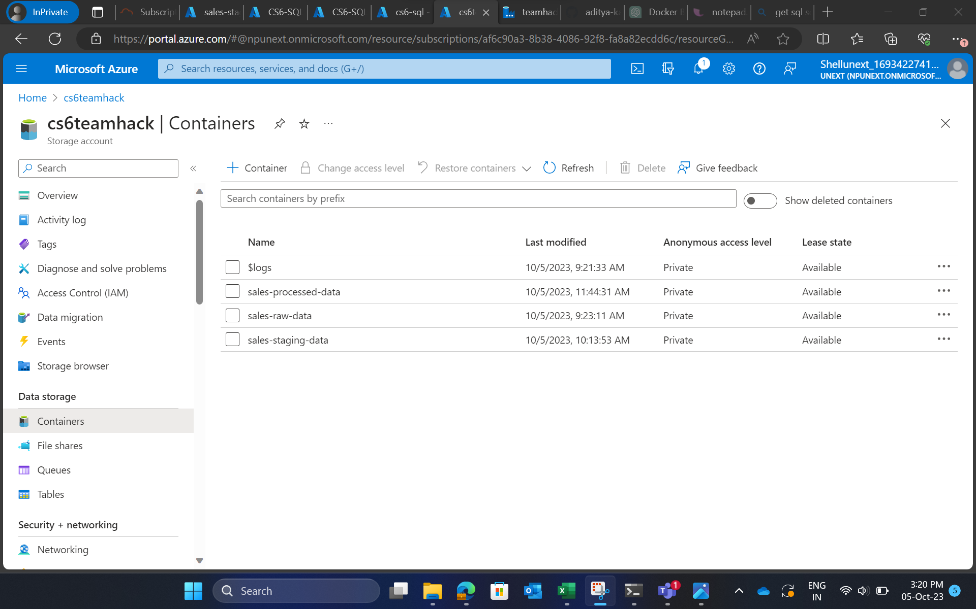
Staging data and processed data saved in Container

Slide 25
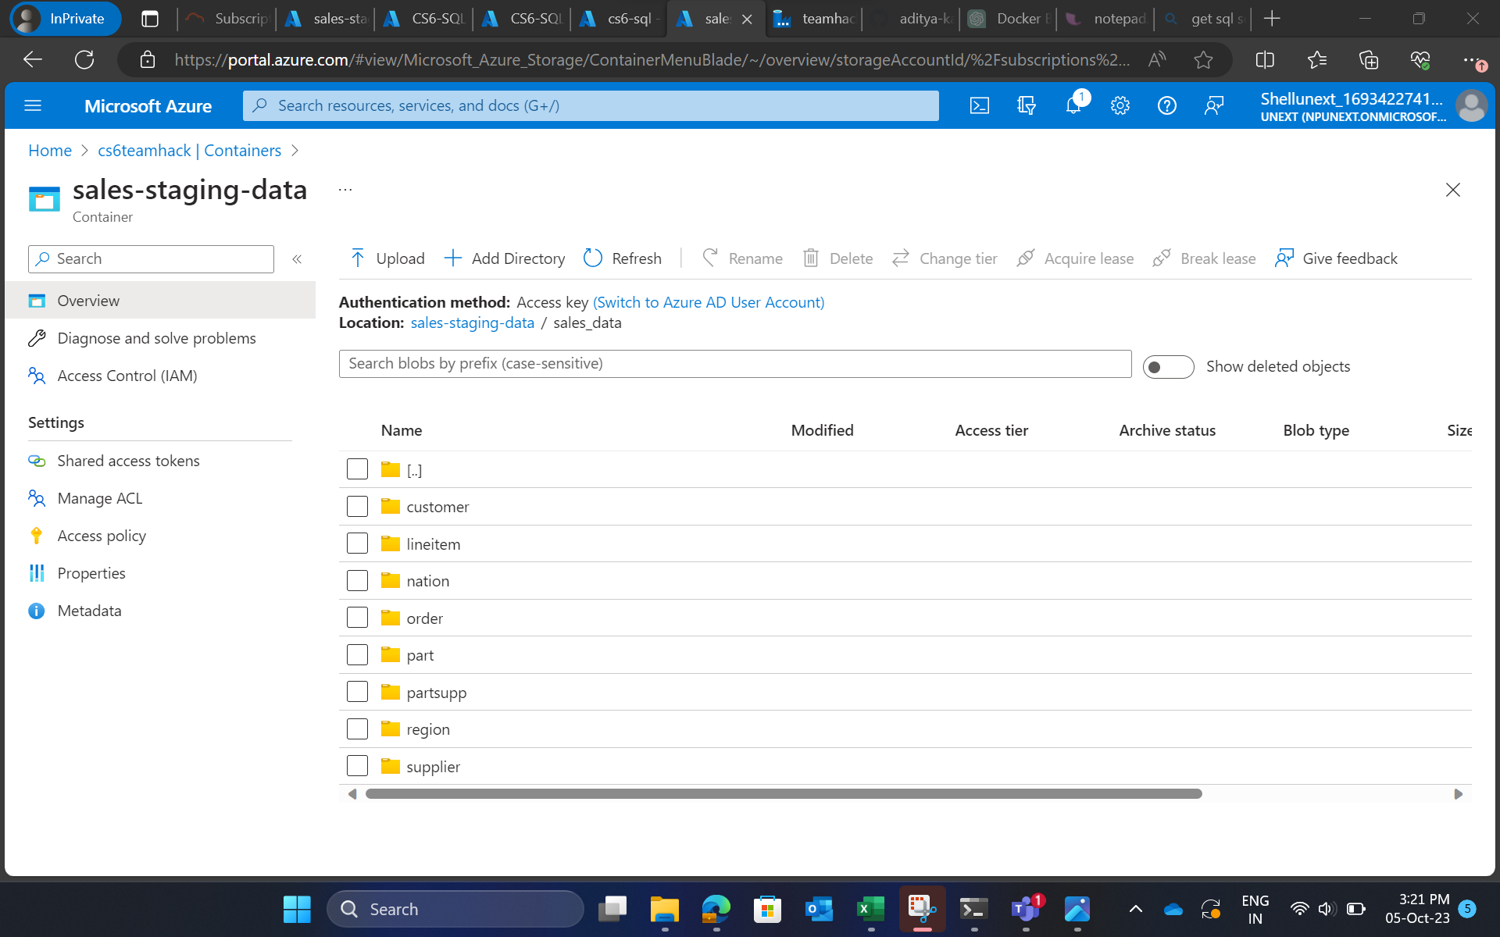

Slide 26
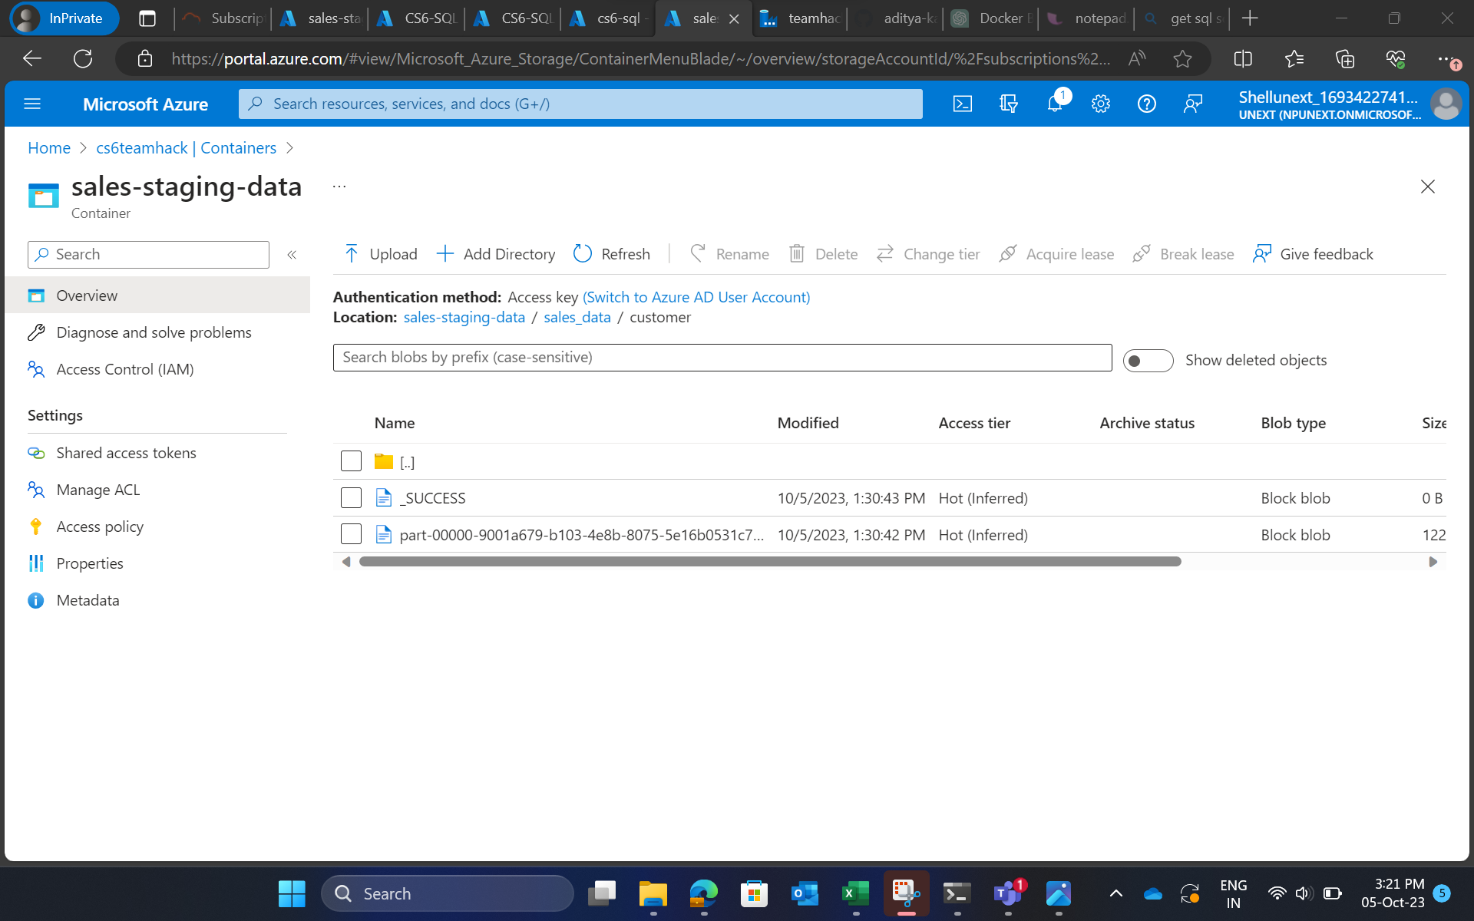

Slide 27
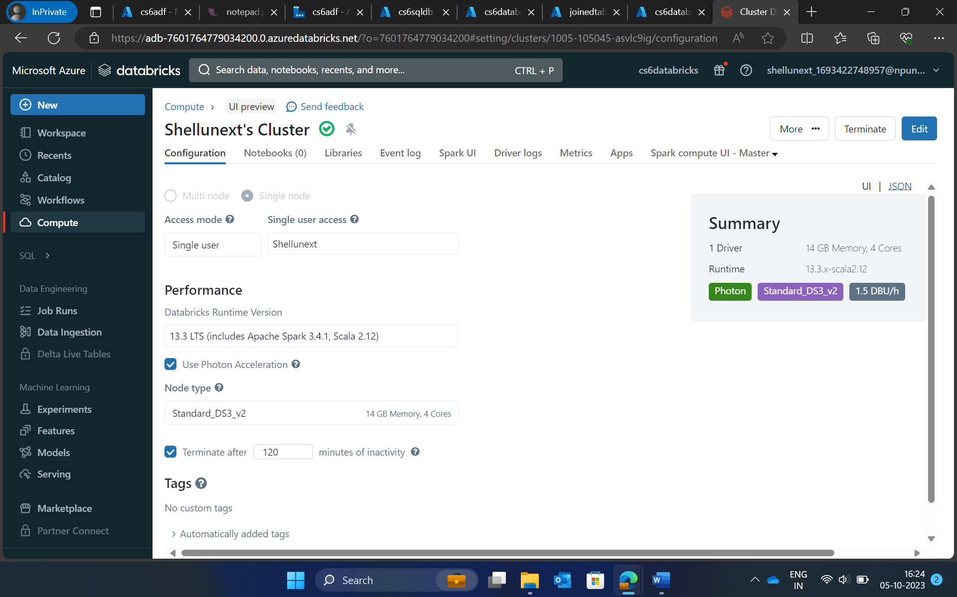
Azure Databricks
Creation of cluster

Slide 28
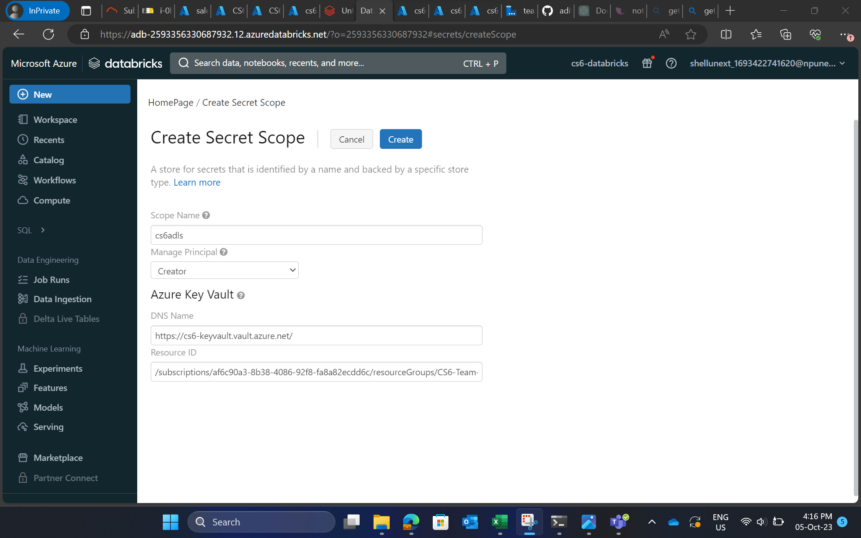

Slide 29
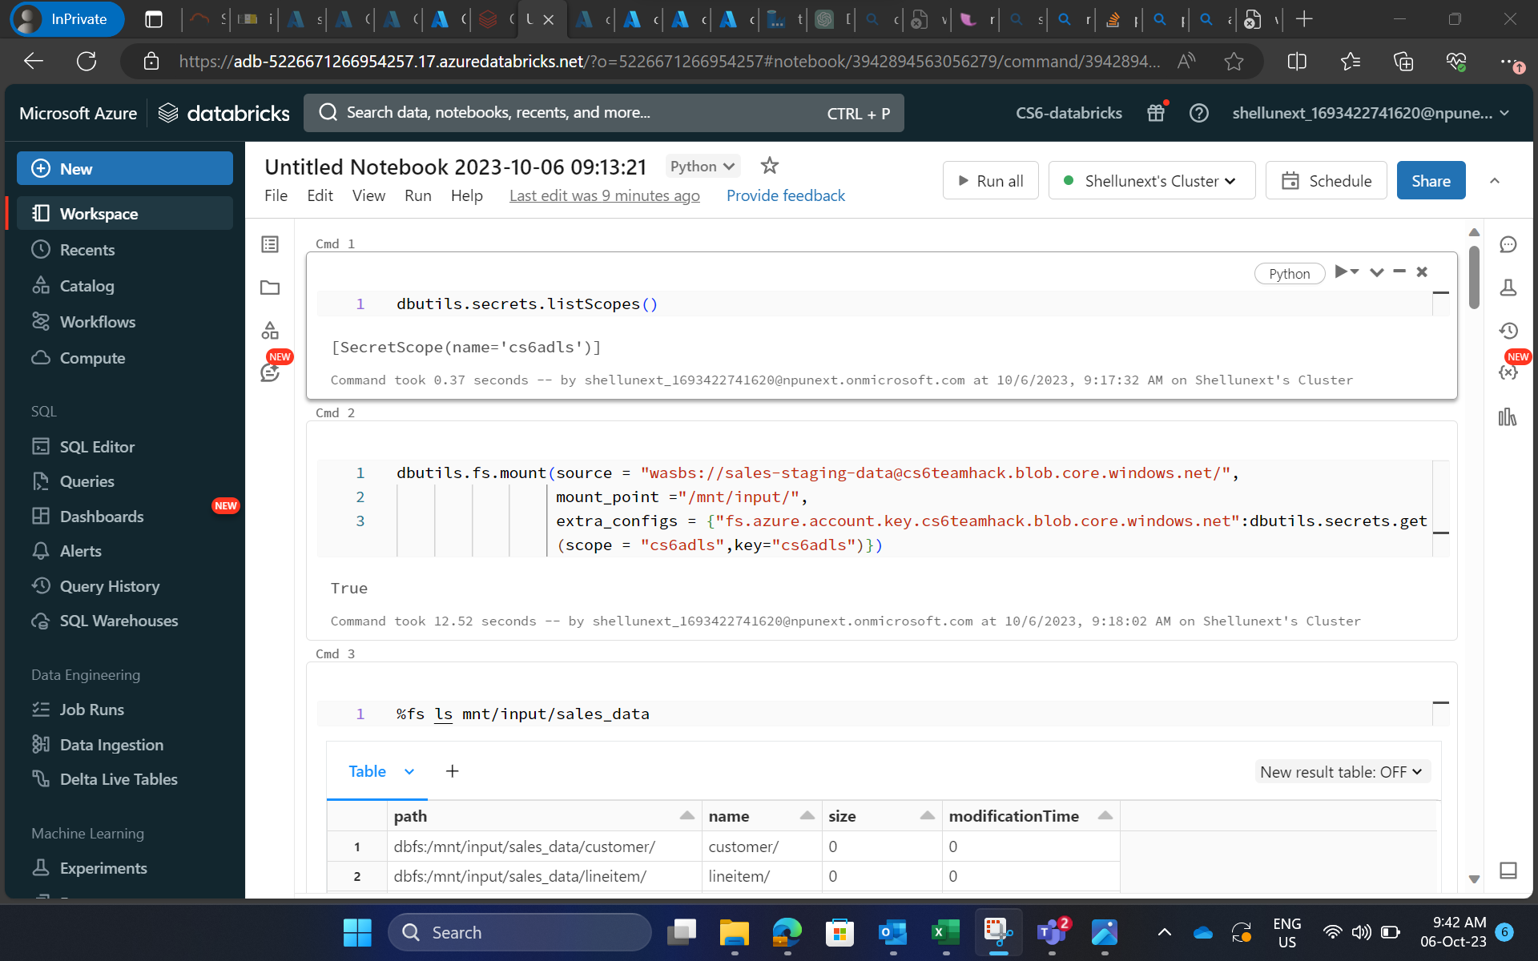

Slide 30
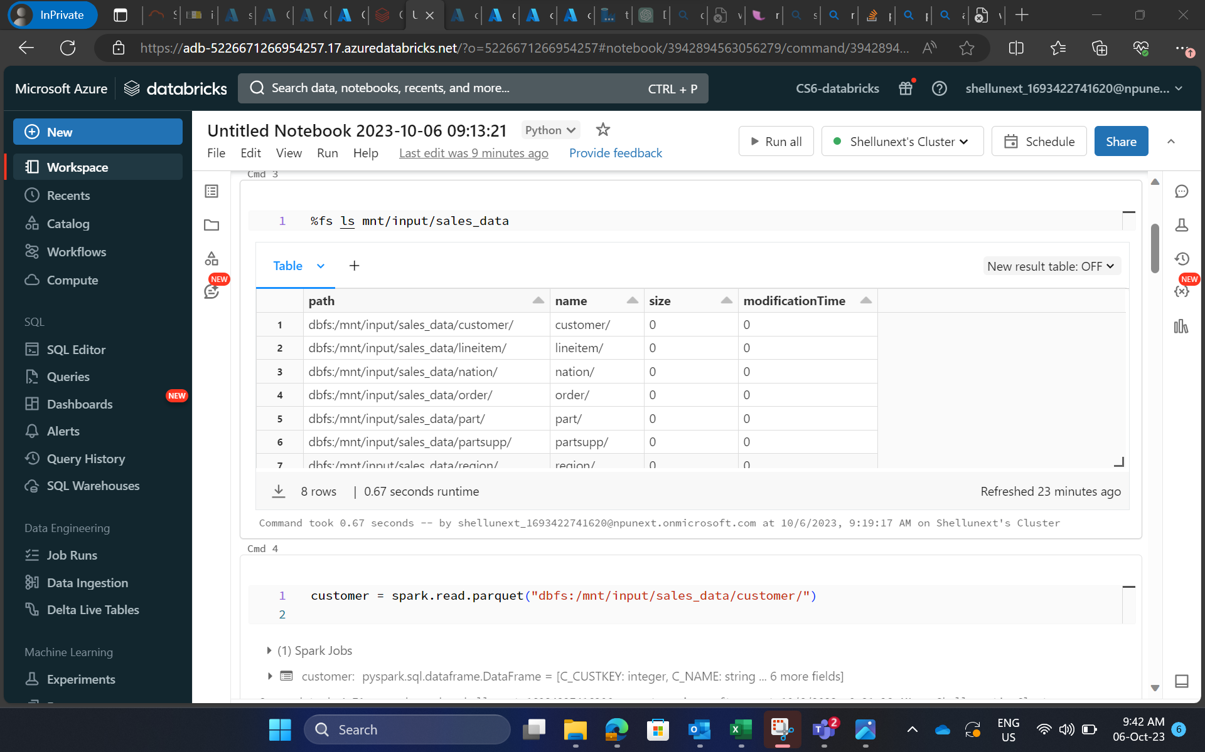

Slide 31
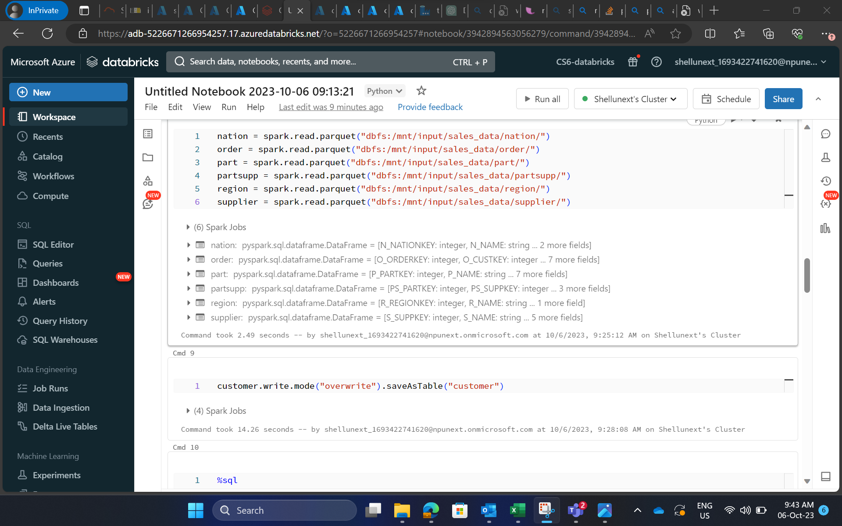

Slide 32
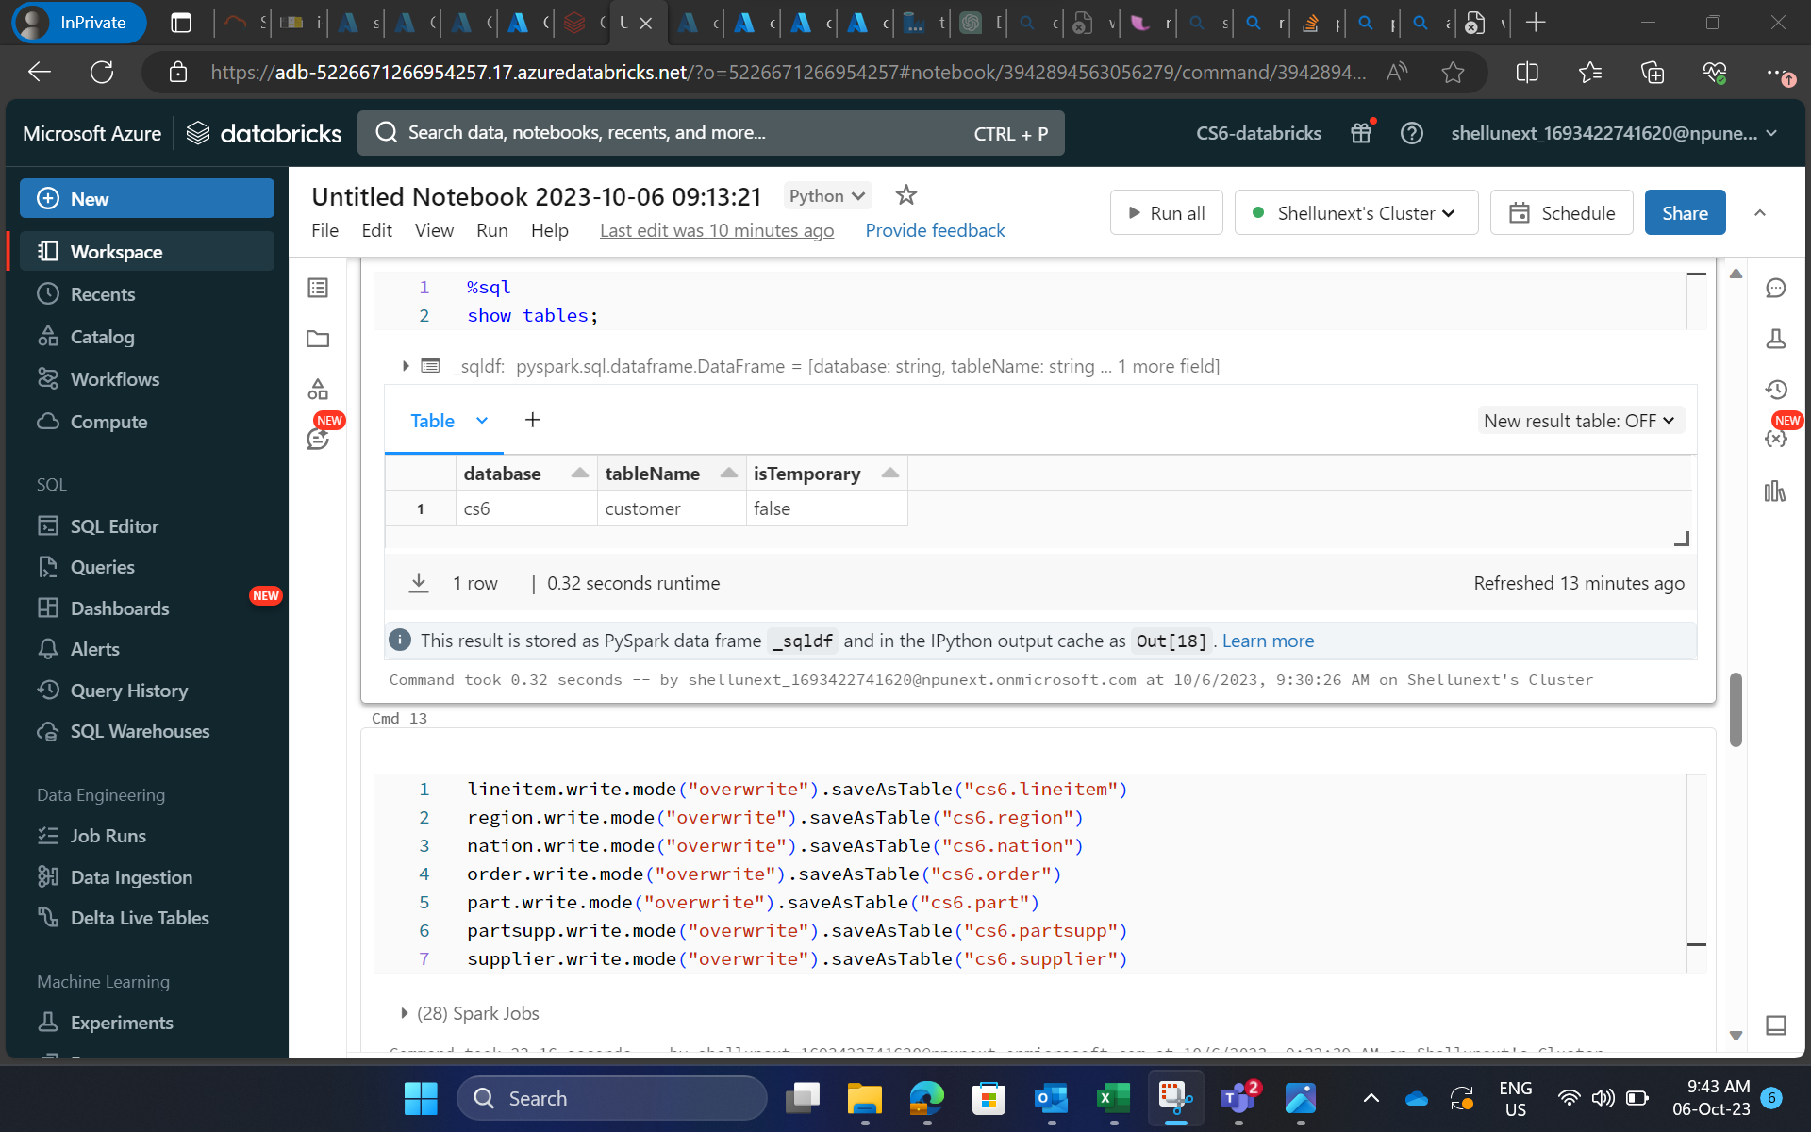

Slide 33
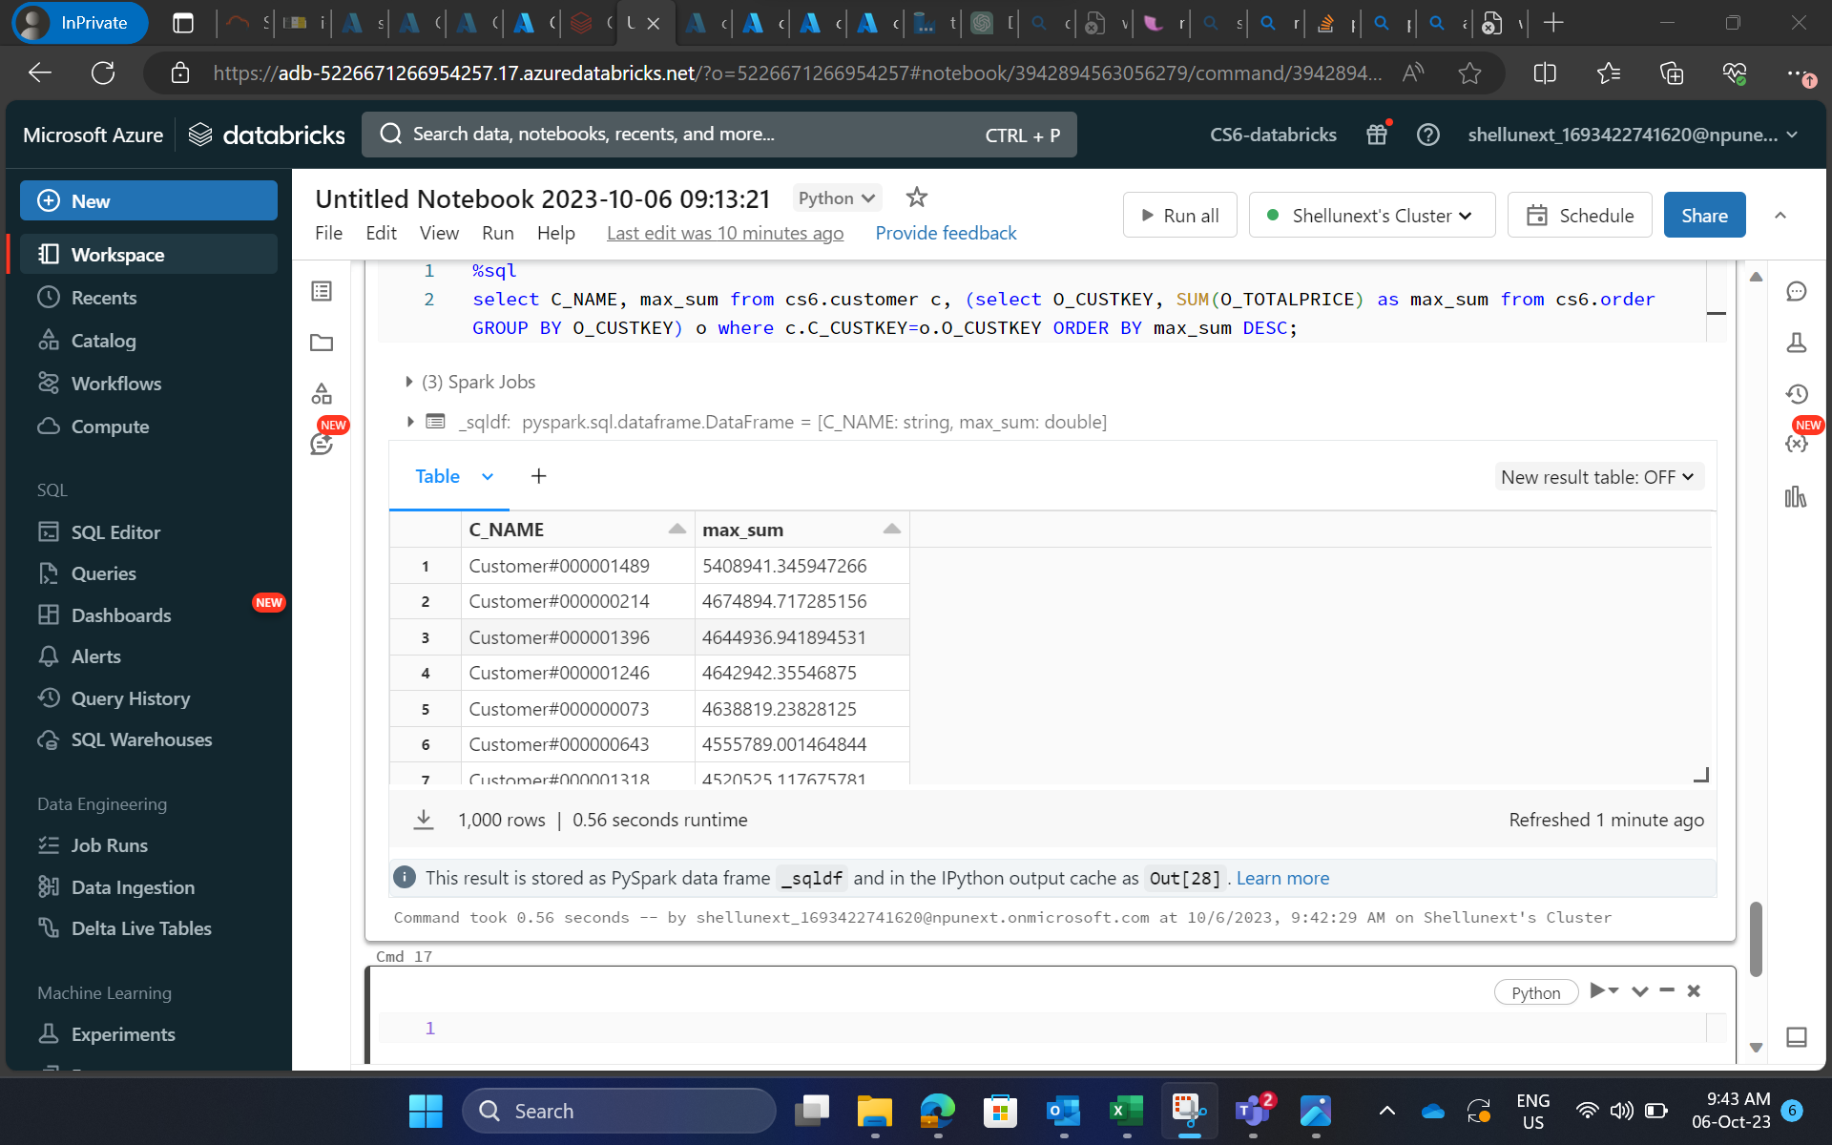

Slide 34
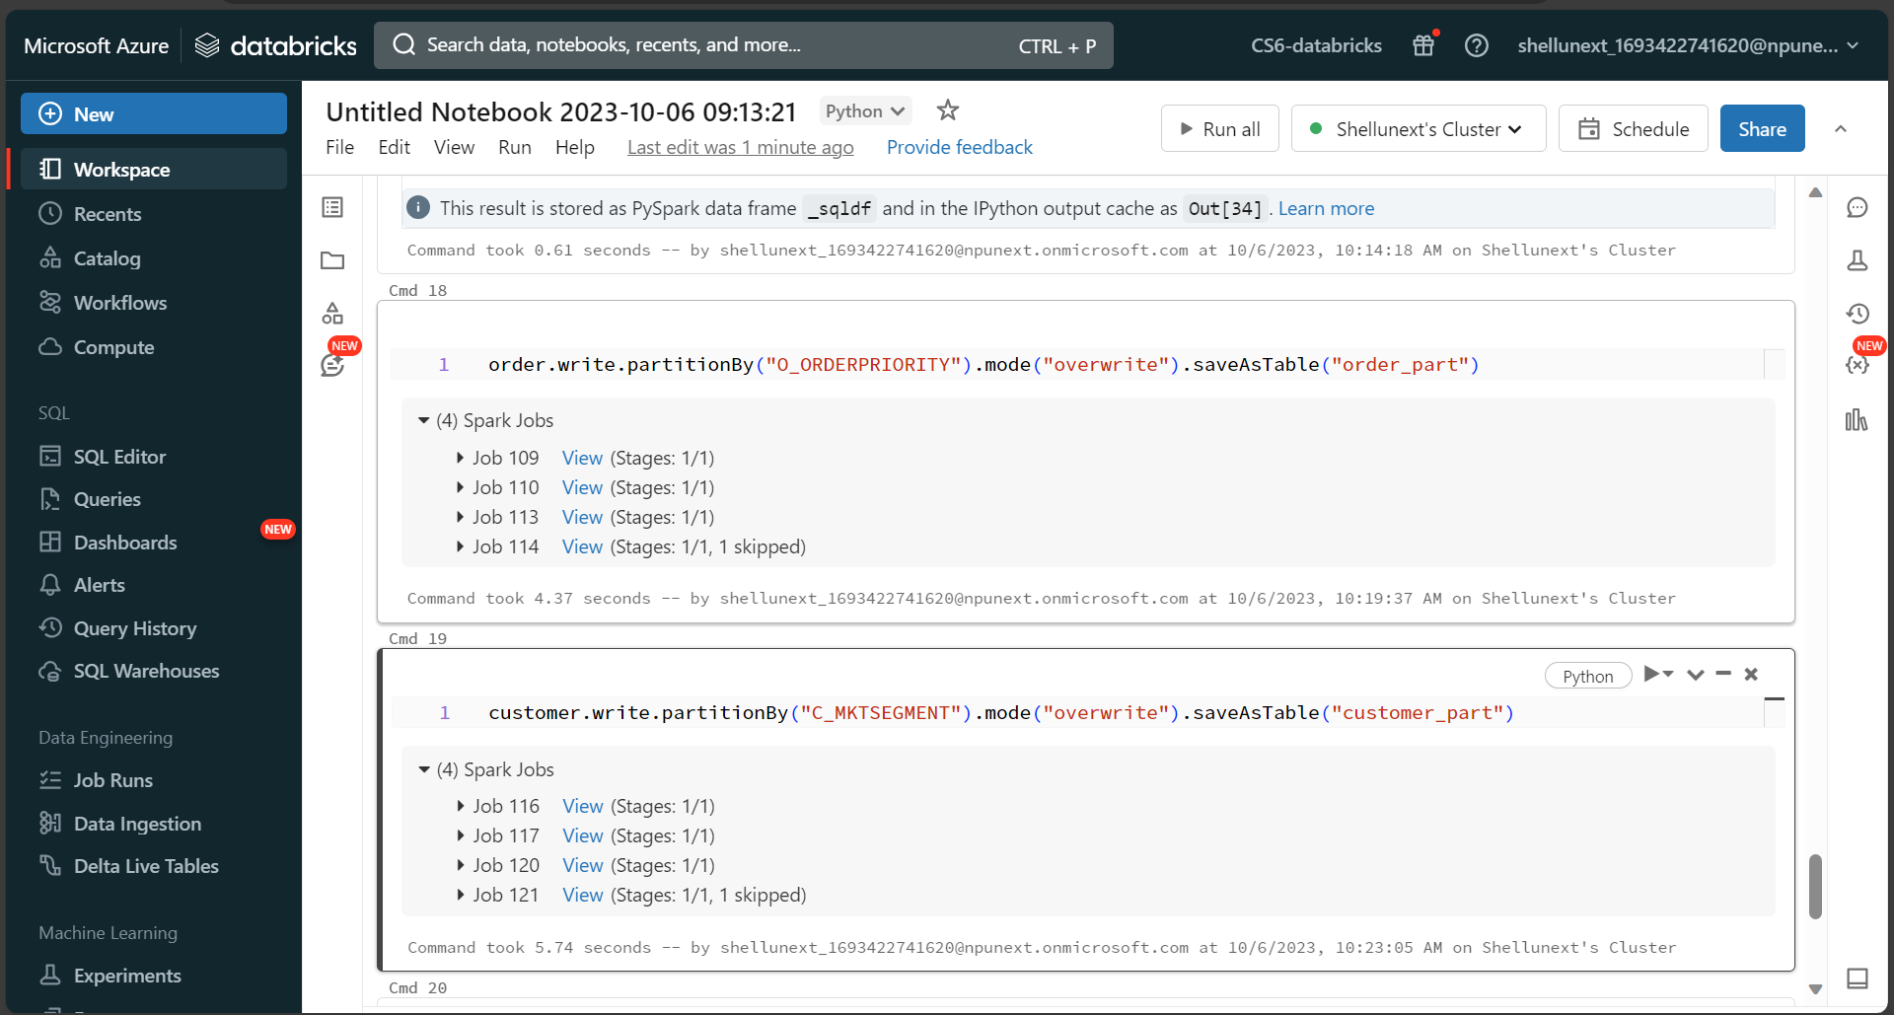

Slide 35
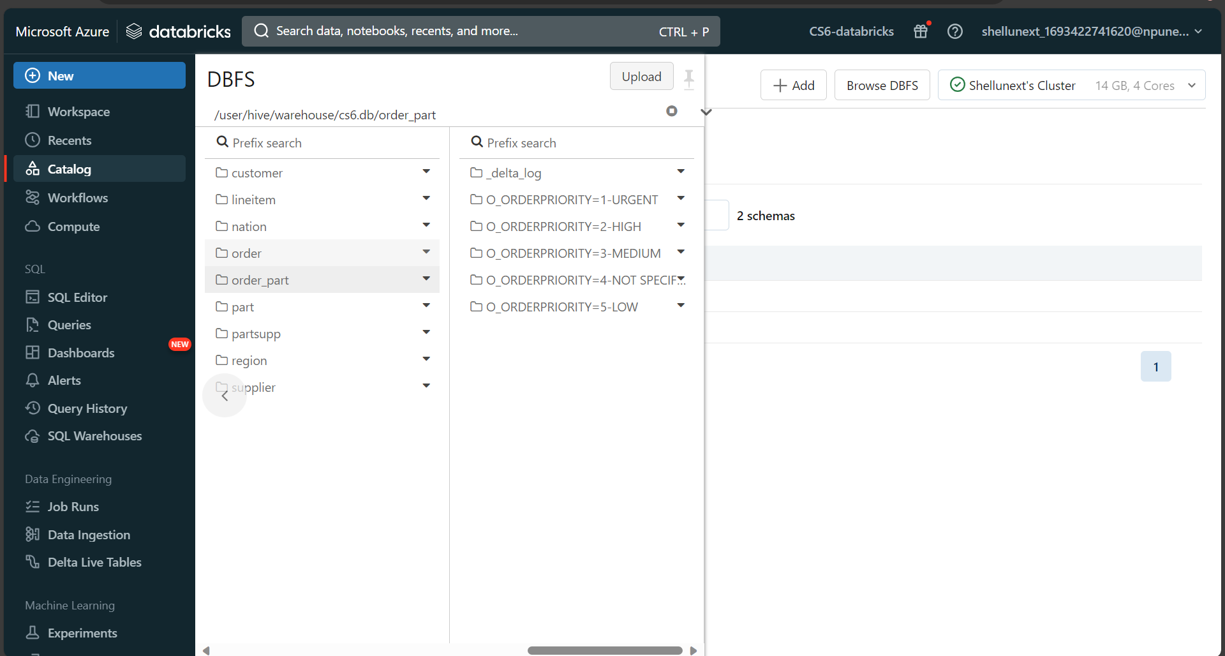

Slide 36
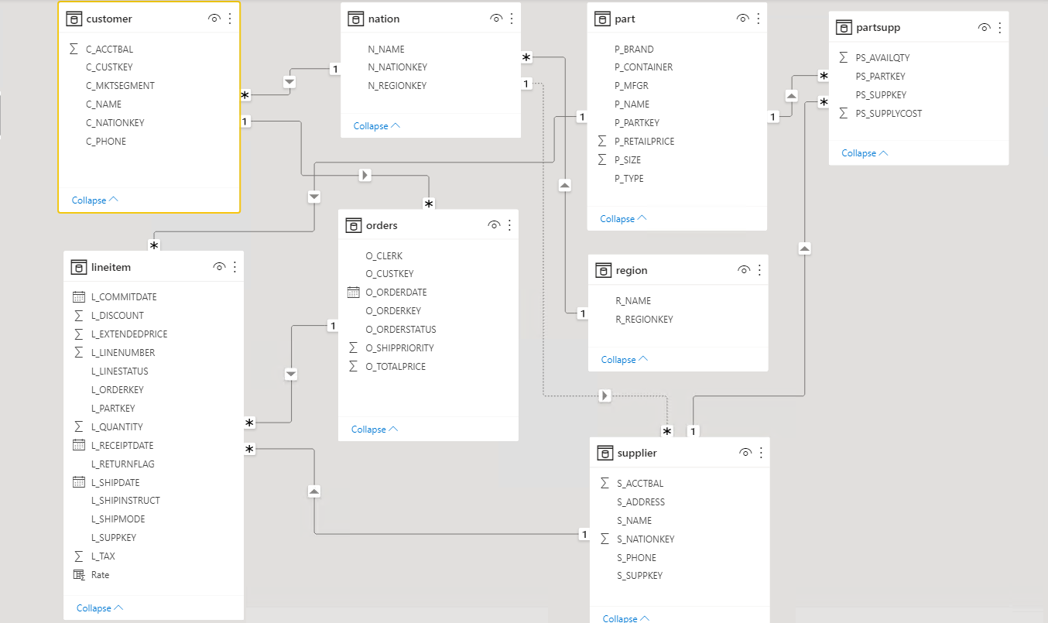
Power BI for data visualization

Slide 37
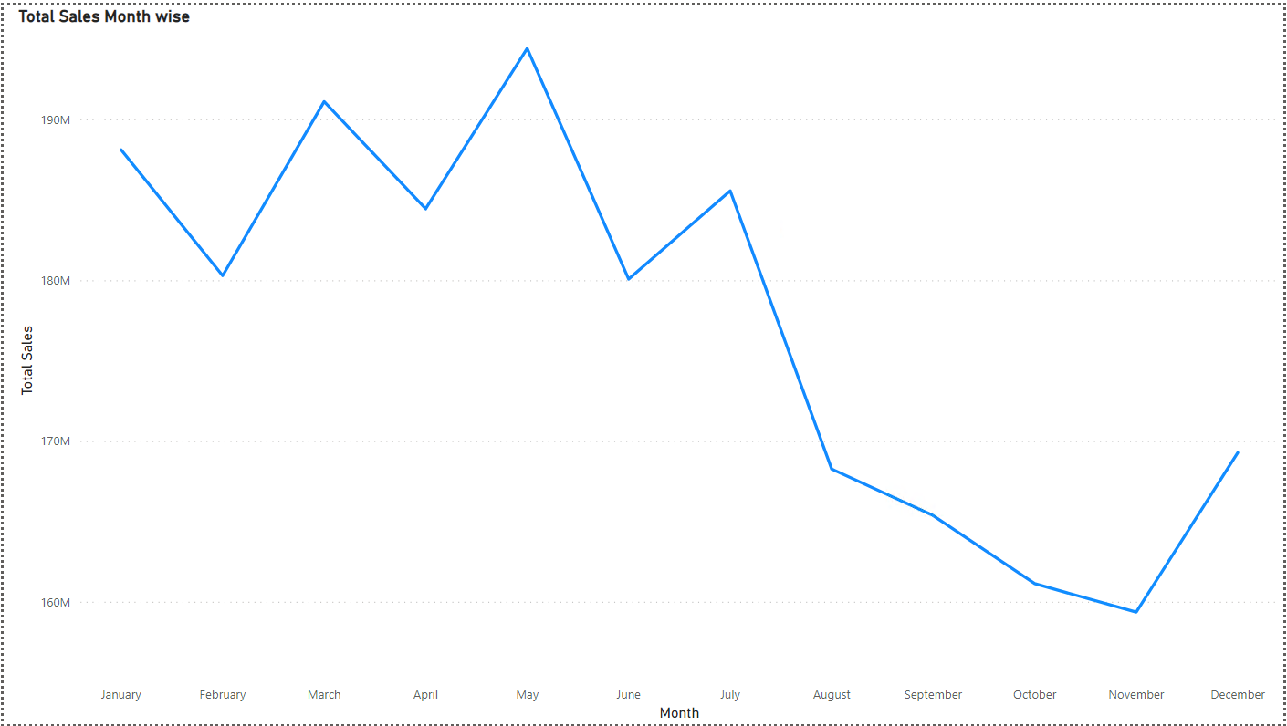
Power BI for data visualization

Slide 38
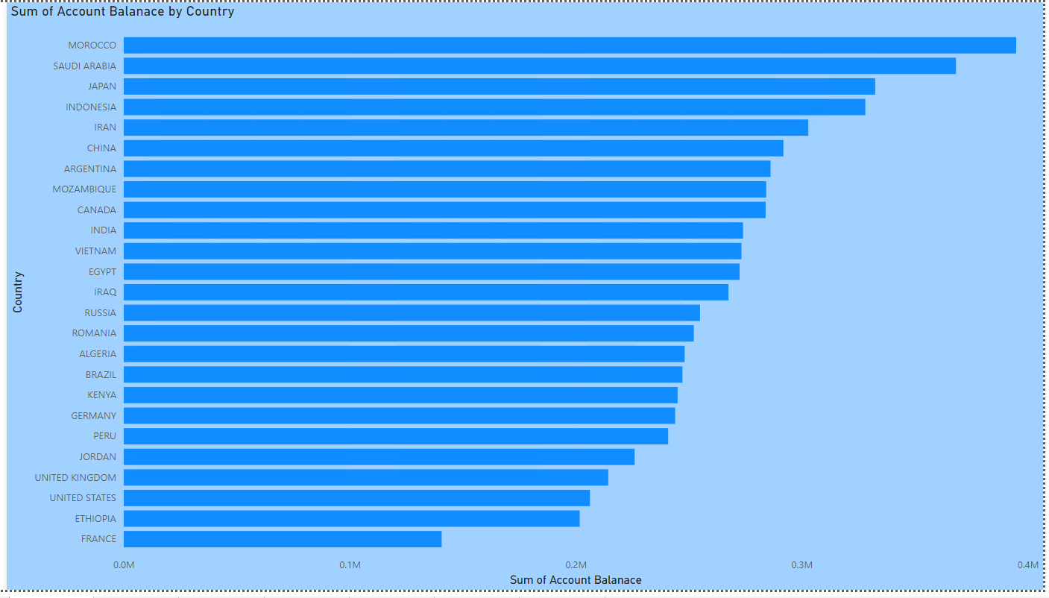
Power BI for data visualization

Slide 39
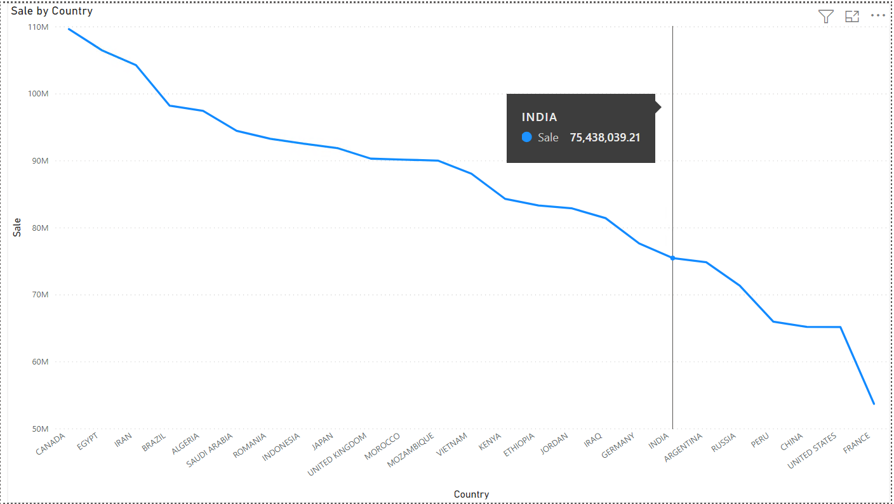
Power BI for data visualization

Slide 40
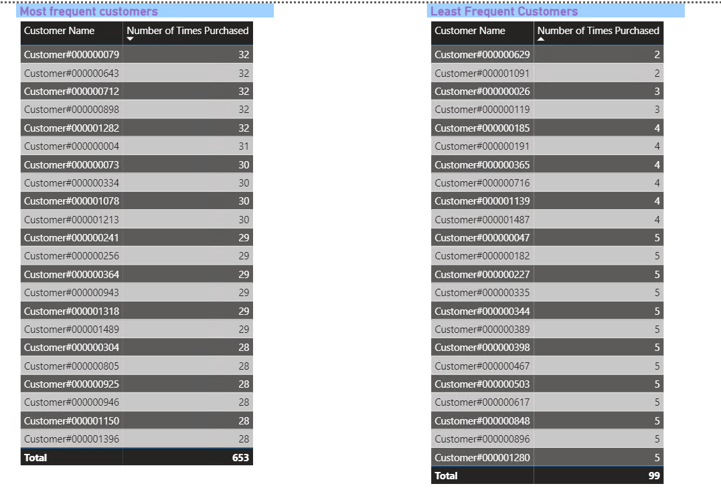
Power BI for data visualization

Slide 41
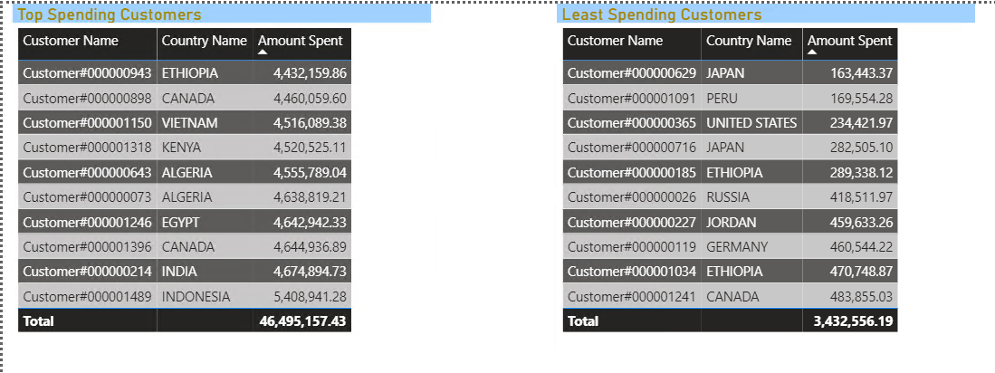
Power BI for data visualization

Slide 42
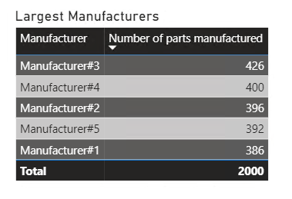
Power BI for data visualization

Slide 44
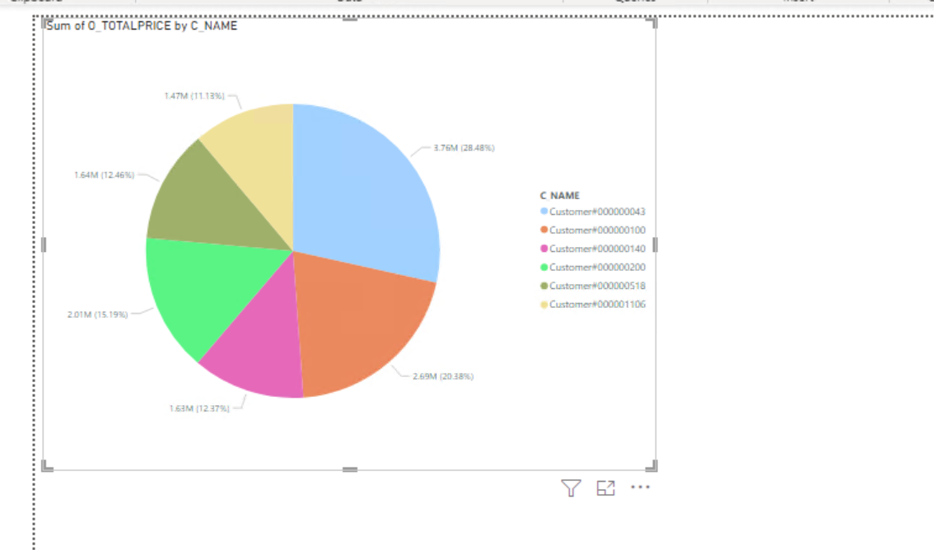

Slide 45
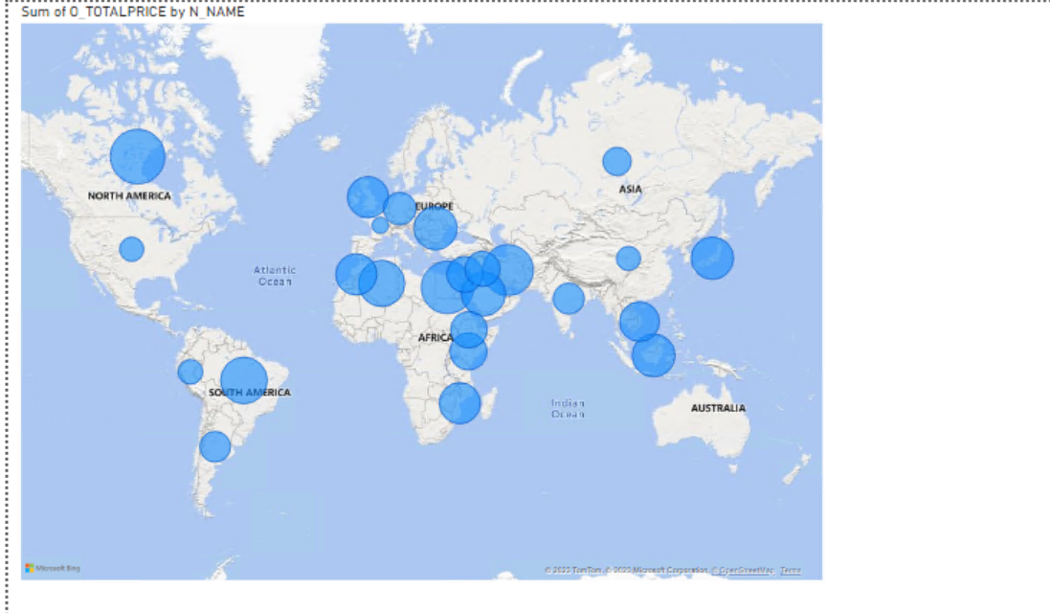

Slide 46
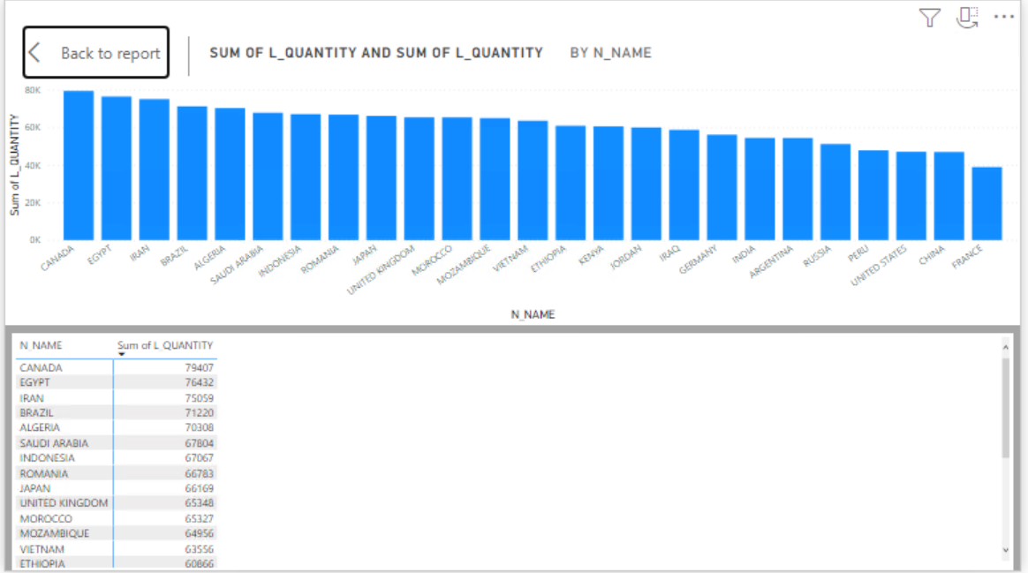

Slide 47
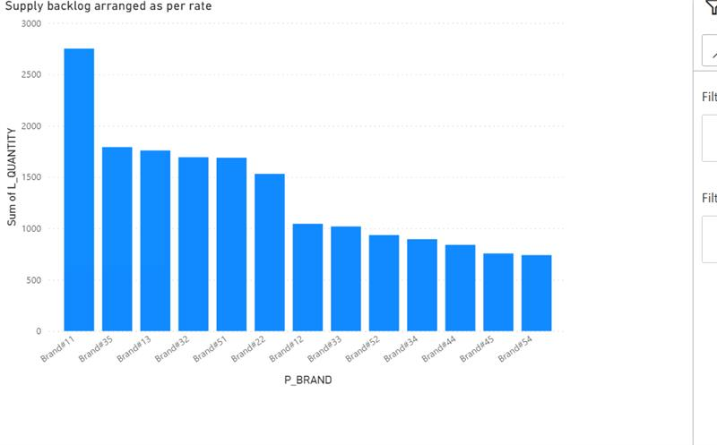

Slide 48
Conclusion
After analysis of the data we came up with the following conclusions.
Canada is the country with the biggest backlog of order delivery, more supplier should be opened up in that region
November sees a steep decline in sales and sales strategies like attractive offers and sales would be recommended to boost sales there
According to the sales hots-spot map created, the African and Sub-European continent have the highest amount of customers and more investment in this region would lead to higher returns.

Slide 49
THANK YOU

